Slide 1
Refugee
Displacements,
Journeys, and
Resettlement Experiences
Dimensions of the Middle East 2019
Michelle S. Dromgold-Sermen mdrom@live.unc.edu

Slide 2
Refugee Displacements, Journeys, and Resettlement Experiences
Global Displacement
Refugees in the Middle East
Refugee Resettlement in the United States

Slide 3
Global Displacement Trivia
1) More than 70 million people worldwide are currently displaced from their homes.
3) About half of the world’s refugees – 51 percent – are children.
4) Refugees decide what country they are resettled to.
True or False?
5) Each country determines which refugees they resettle.
2) Only 2 out of every 5 refugees live in countries neighboring their country of origin.
Adapted from: www.greateras1.org.

Slide 4
1) True. On June 19, 2019, UNHCR reported that there were almost 70.8 million forcibly displaced people worldwide in 2018. This is likely an undercount, because it does not include all Venezuelan displacement (https://www.bbc.com/news/world-48682783 ).
3) True. On June 19, 2019, the UNHCR reported that “children below 18 years of age constituted about half of the refugee population of 2018”.
ANSWER KEY
4) False. Refugees do not get to decide what country they are resettled to.
5) True. Each country determines which and how many refugees they resettle.
2) False. According to the UNHCR, nearly 4 out of every 5 refugees lived in countries neighboring their countries of origin in 2018.
Source: United Nations High Commission on Refugees (UNHCR). 2019. Global Trends 2018.

Slide 5
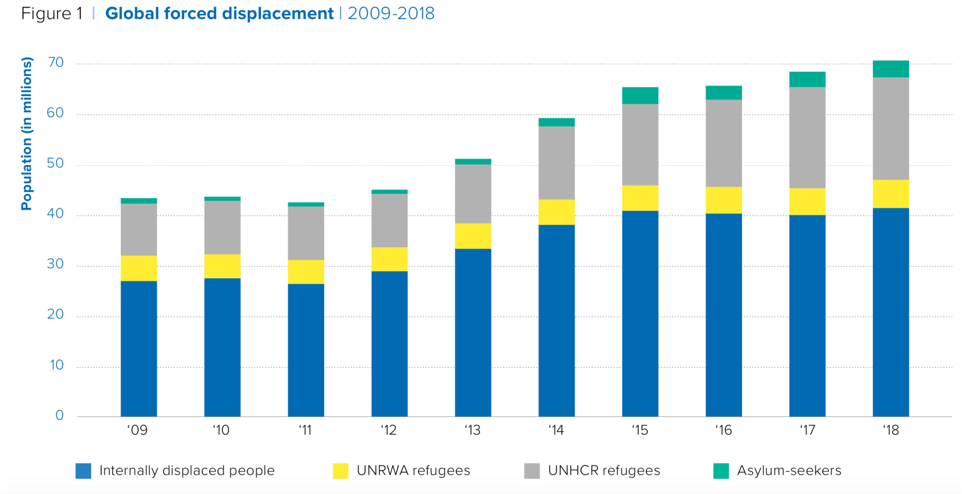
Global Displacement
Refugees: Where they come from and where they go
Source: United Nations High Commission on Refugees (UNHCR). 2019. Global Trends 2018; See definitions at: https://www.unrefugees.org/reugee-facts/what-is-a-refugee/.; https://www.iom.int/key-migration-terms#refugee

Slide 6
A refugee is someone who has been forced to flee his or her country because of persecution, war or violence.
A refugee has a well-founded fear of persecution for reasons of race, religion, nationality, political opinion or membership in a particular social group.
Definition from: https://www.unrefugees.org/refugee-facts/what-is-a-refugee/.
Who is a refugee?
Camp for Syrian refugees in Lebanon

Slide 7
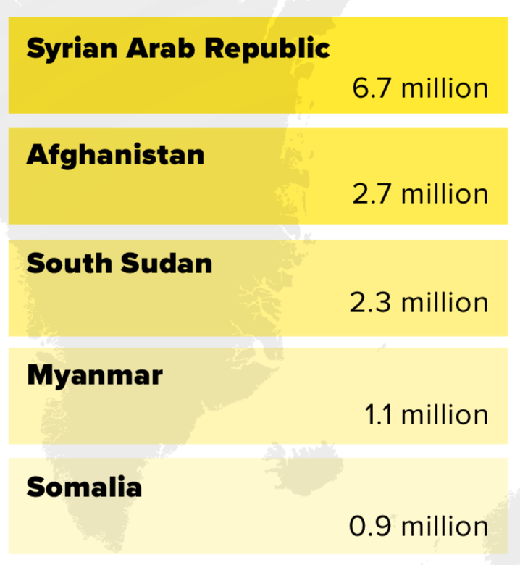
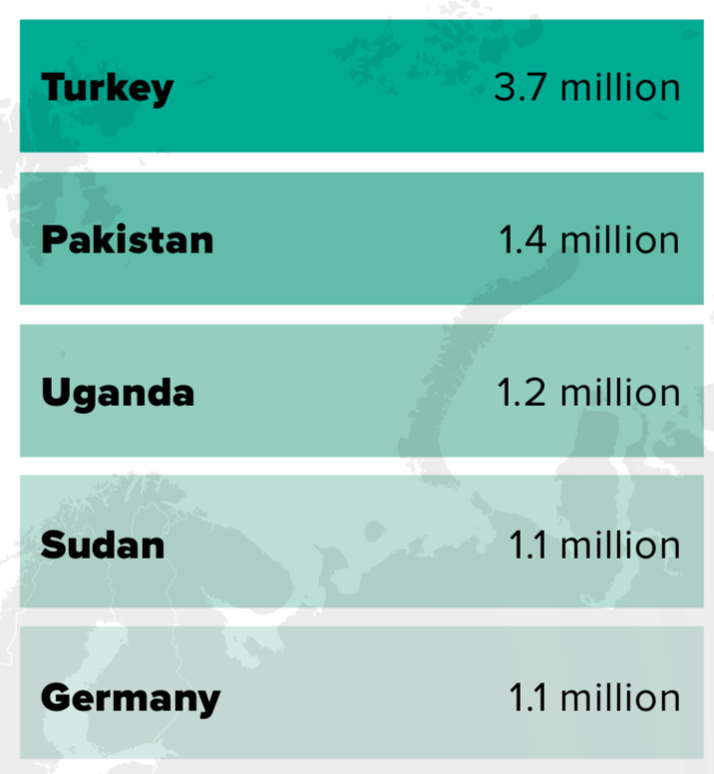
What countries are refugees fleeing?
What countries host refugees?
In 2018
more than two-thirds
(67 percent) of all refugees came from just five countries:
Source: United Nations High Commission on Refugees (UNHCR). 2019. Global Trends 2018.

Slide 8
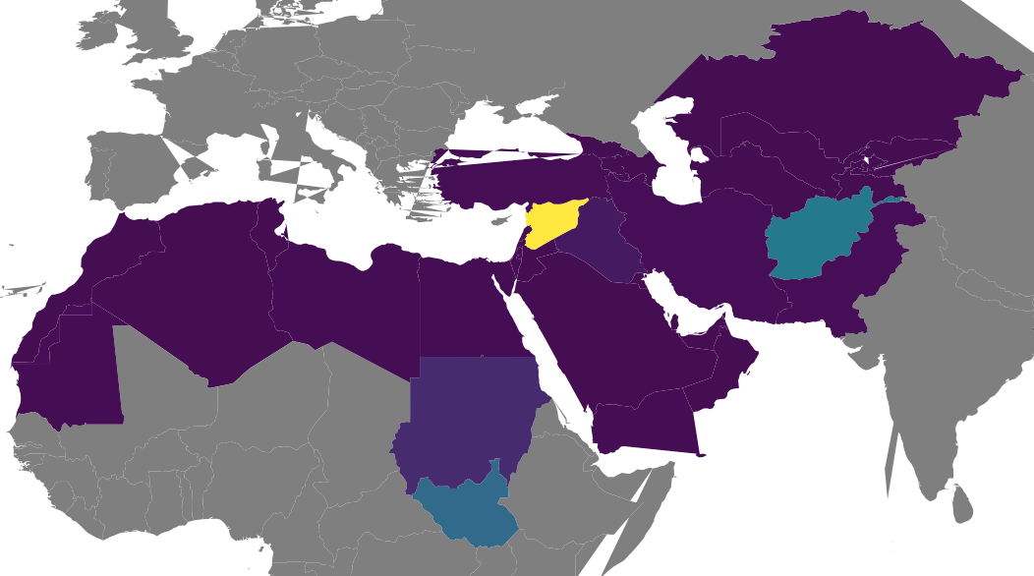
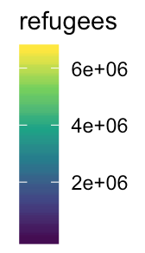
Refugees* displaced from countries in the Middle East, 2018
*Data shown here does not include Palestinian refugees, who are counted separately by UNRWA
Source: United Nations High Commission on Refugees (UNHCR). 2019. Global Trends 2018.

Slide 9
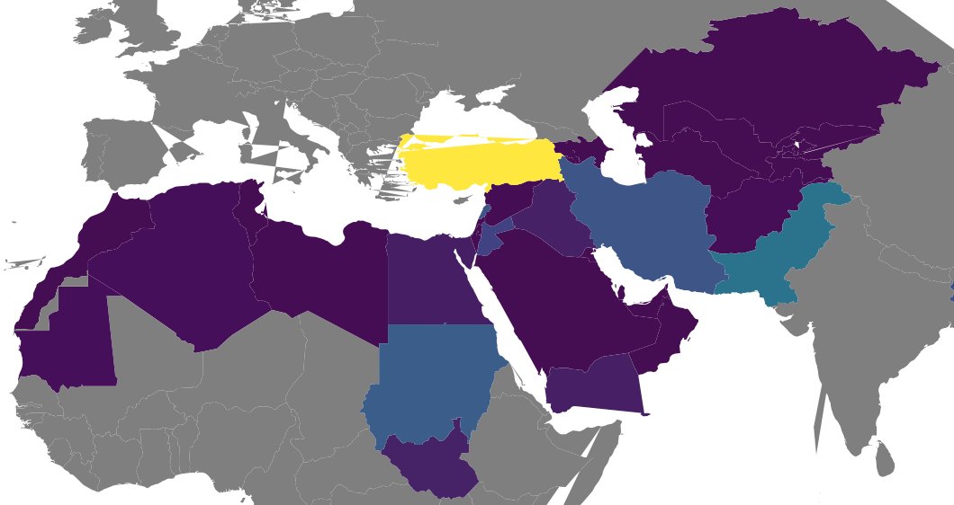
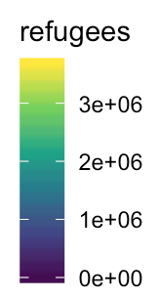
Refugees* hosted by countries in the Middle East, 2018
*Data shown here does not include Palestinian refugees, who are counted separately by UNRWA
Source: United Nations High Commission on Refugees (UNHCR). 2019. Global Trends 2018.

Slide 10
What is life as a refugee like?
Experience of Trauma
Dangerous journeys
Uncertainty
Family Separation
Discrimination
Violence

Slide 11
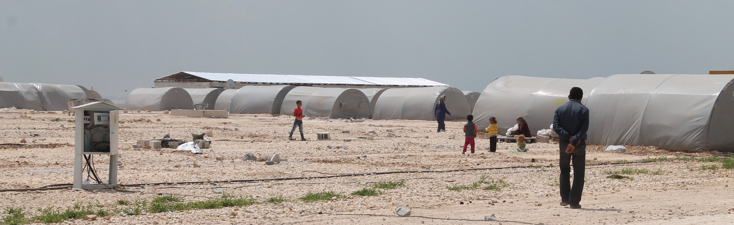
TURKEY
Life in the Camp
versus
Life in the City
LEBANON
  Access to Health Care
  Access to Food
  Access to Shelter
  Access to Work
  Access to Education
  Safety (sexual violence and rape, fire, etc.)
  Privacy and Community
  Language
JORDAN
Top: Bab-Al-Salam, Photo 2018
Bottom: Zaatari Refugee Camp hosts 78,908 refugees and is Jordan’s fourth largest city, Photo
Top: Camp in Urfa run by AFAD (the Turkish equivalent of FEMA), Photo 2015
Middle: Camp in Suruç across the border from Kobane and run by the local municipality, Photo 2015
Bottom: A ‘container town’ camp in Kilis, run by AFAD, Photo 2012

Slide 12

The Story of
Hinan and Mohammed and their five children:
Yusuf, Youssri, Omar, Maram and Hamudi

Slide 13
Who is a refugee?
A refugee is someone who has been forced to flee his or her country because of persecution, war or violence.
A refugee has a well-founded fear of persecution for reasons of race, religion, nationality, political opinion or membership in a particular social group.
Definition from: https://www.unrefugees.org/refugee-facts/what-is-a-refugee/.
Is migration forced? Or is it a choice?
Forced
(Refugee or Asylee)
Choice
(Economic migrant)

Slide 14
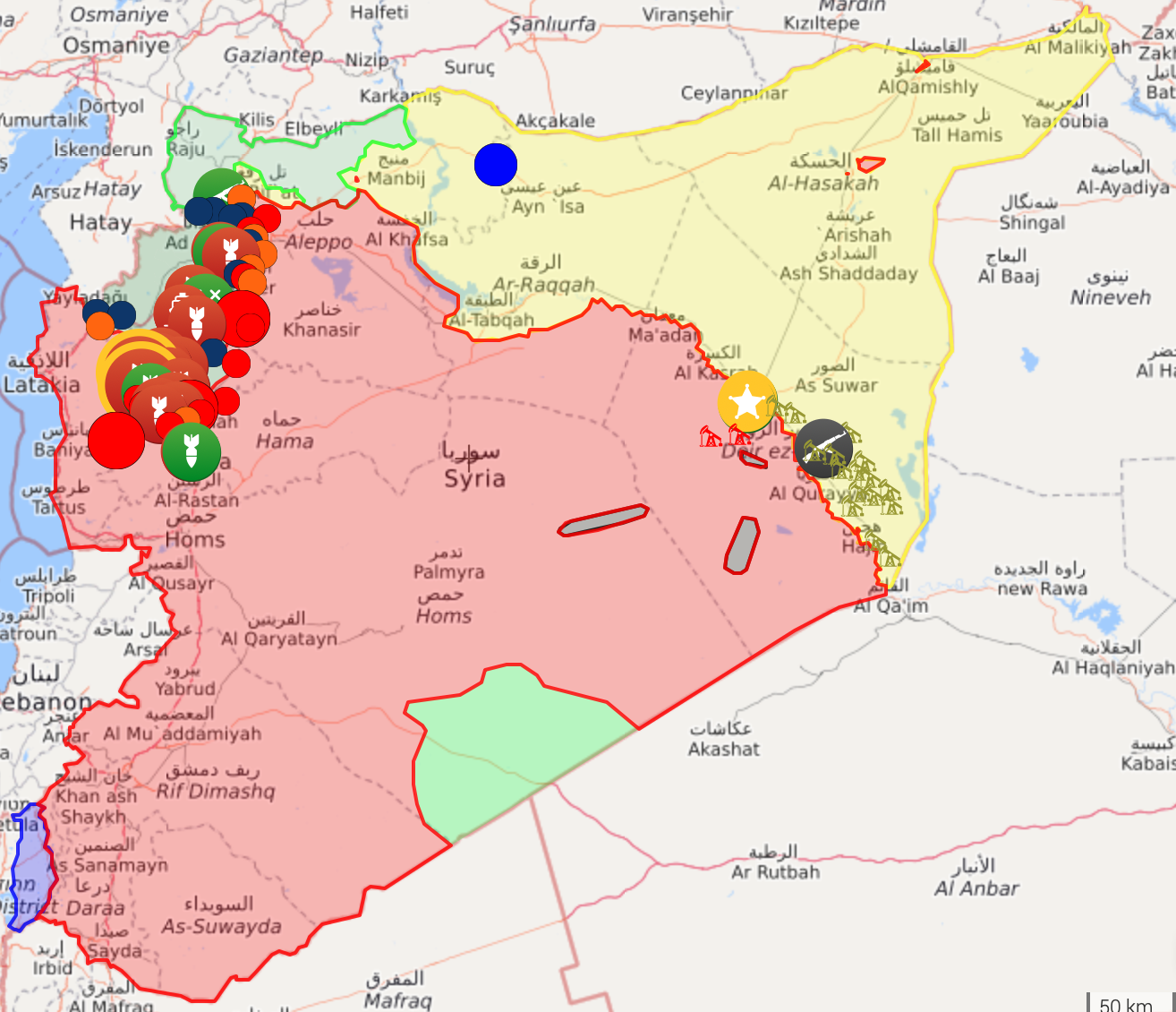
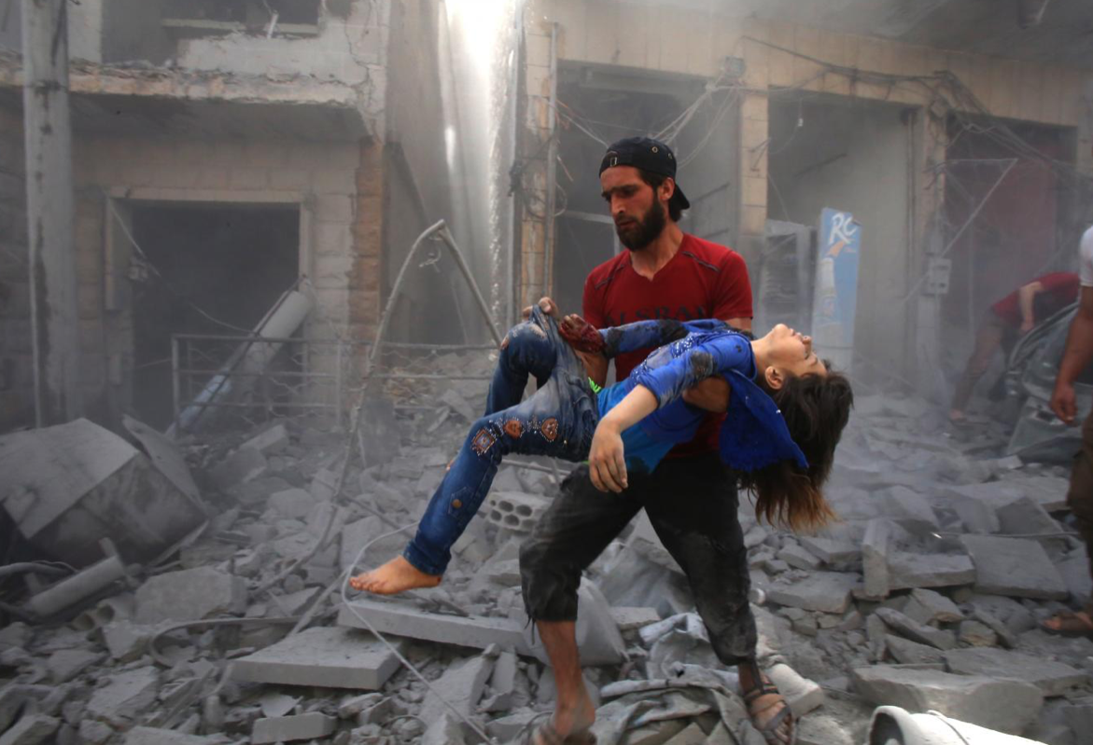
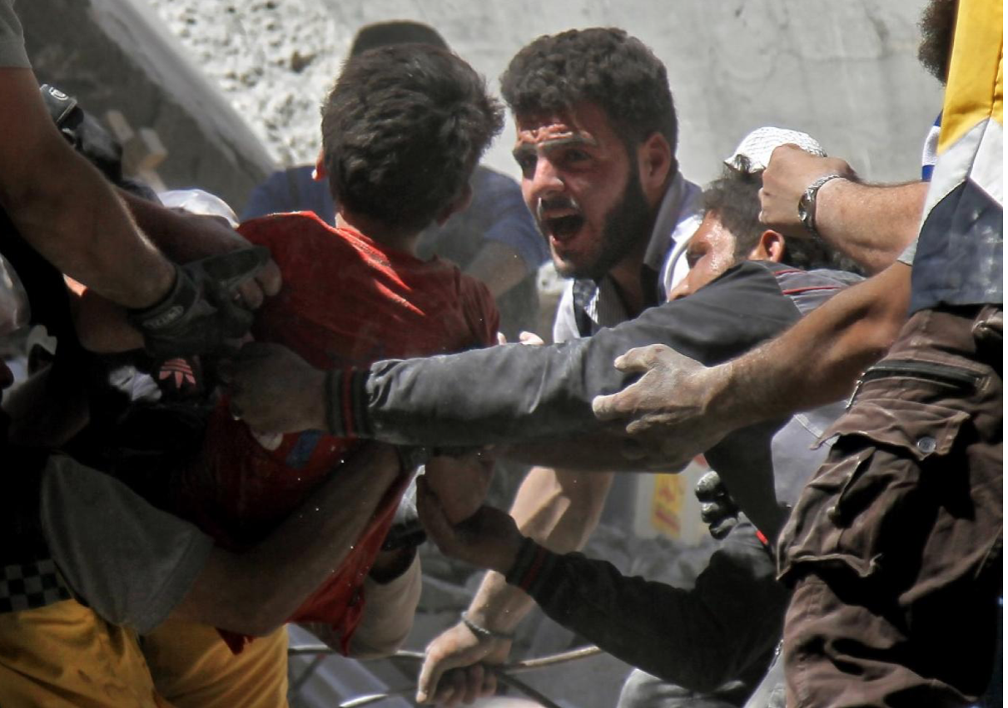
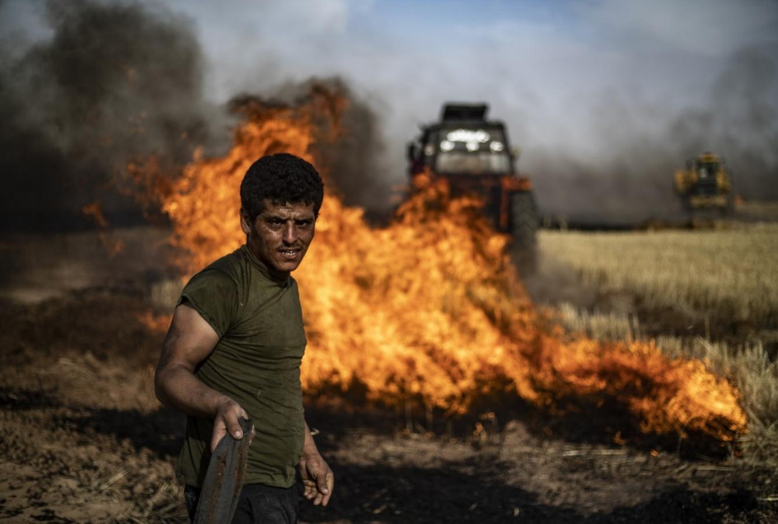
Is the Syrian Civil War over?
“No Ceasefire in Idlib: Turkish soldiers wounded as clashes continue despite ‘truce’”
“Dozens of combatants reported dead during clashes and air strikes in Syria’s Hama”
“At least 10 people reported killed by fires engulfing wheat fields in northwest Syria”
News headlines from Middle East Eye (https://www.middleeasteye.net), dated June 13, June 15 and June 16 (top to bottom).
Map from https://syria.liveuamap.com/en.

Slide 15
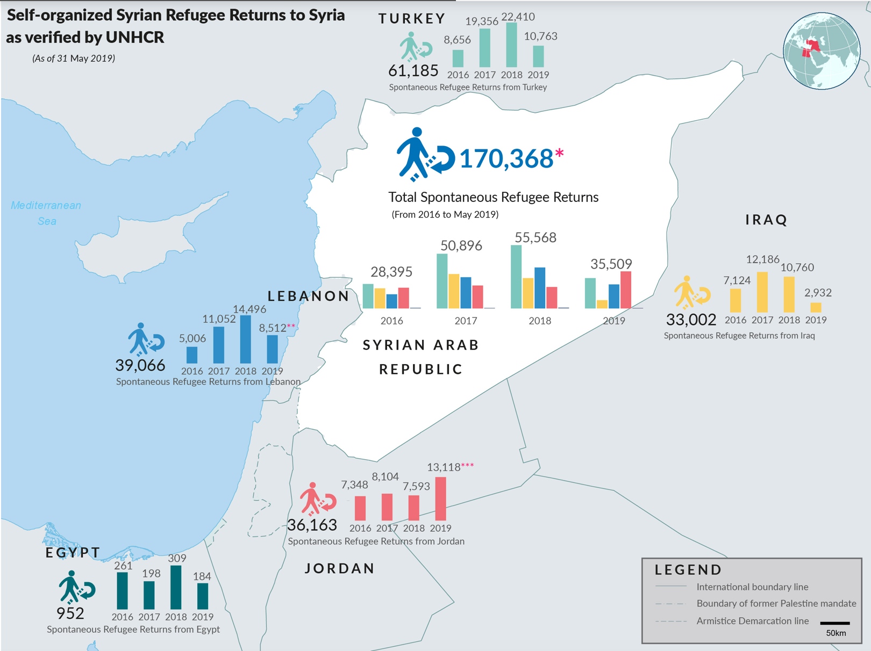
The future of refugee displacement and return in the Middle East
‘Safe and Dignified Return’?
From Europe:
  In March, Denmark passed a policy to begin returning Syrians from Damascus who were given ”general situation” temporary protection.
  As of April, there was a block in Germany on repatriating any Syrians
Ongoing conflicts in the region
Emerging instability and conflicts
Environmental events
Economic insecurity and inflation
Future of Refugee Displacement
From articles on www.infomigrants.net, https://syriadirect.org and https://data2.unhcr.org/en/situations/syria_durable_solutions.

Slide 16
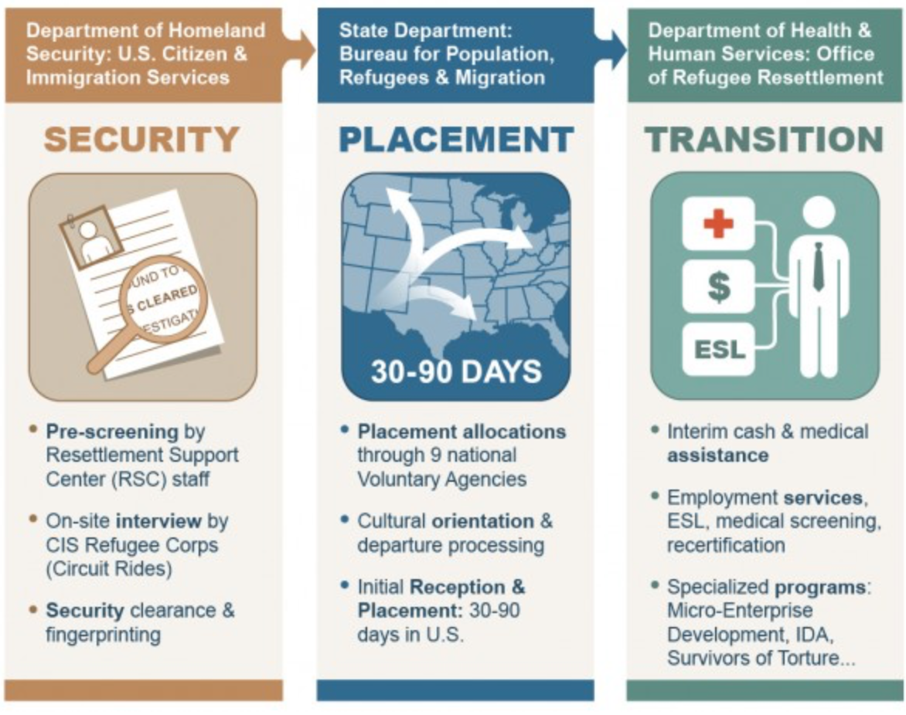
Resettlement in the United States
Source:
U.S. Office of Refugee Resettlement. https://www.acf.hhs.gov/orr.

Slide 17
U.S. Refugee Admissions from 1975 to May 31, 2019, by Fiscal Year
1980 Refugee Act
September 11, 2001
Source: Department of State Bureau of Population, Refugees, and Migration; Office of Admissions – Refugee Processing Center. http://www.wrapsnet.org/admissions-and-arrivals.

Slide 18
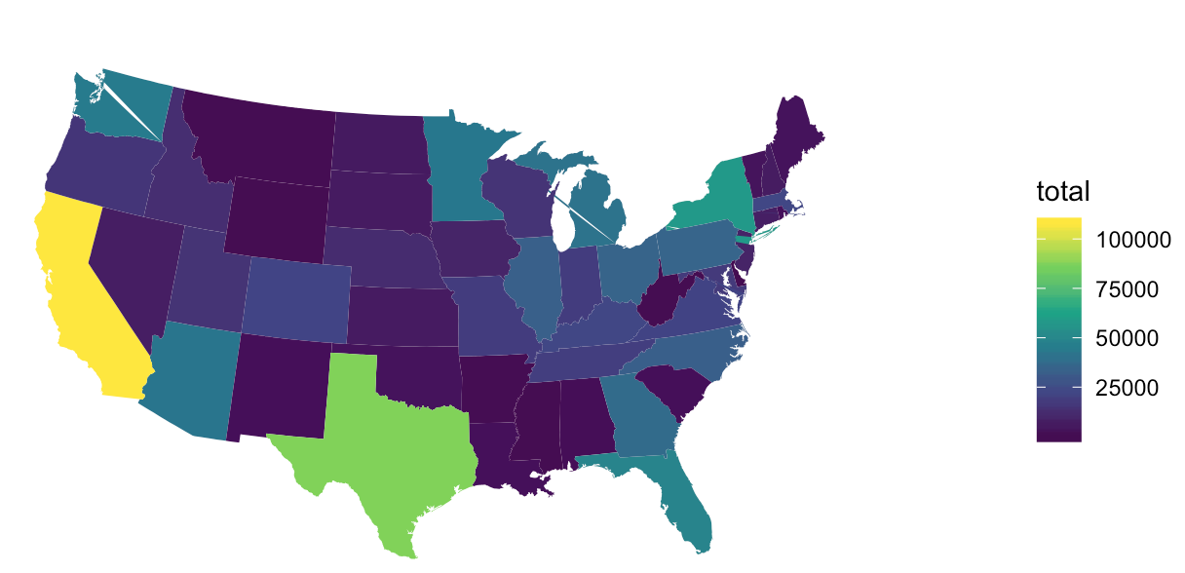
Refugee Arrivals from Fiscal Year 2002 until Present, by State*
*The 1,352 refugees resettled in Alaska, 127 resettled in Hawaii, 49 resettled in Puerto Rico and 5 resettled in Guam for the given period are not show here.
Source: Department of State Bureau of Population, Refugees, and Migration; Office of Admissions – Refugee Processing Center. http://www.wrapsnet.org/admissions-and-arrivals.

Slide 19
Additional Resources
Packet (also available on Sakai)
Powerpoint slides
Additional powerpoint slides:
  Global Displacement
  Refugees in the Middle East
  Resettlement
  Stories from refugee families resettled in the United States (please share only with your students; note that Eggleston and all names are pseudonyms)
Feel free to reach out by e-mail with any questions: mdrom@live.unc.edu

Slide 20
Global Displacement: History
People have always been mobile, moving between villages and often migrating from rural to urban areas in search of better economic and personal opportunities. But in the last one hundred years, the proportion of the world’s population that has been forced to leave their homes has increased.
The Holocaust and the genocide of minority groups in Europe during World War II prompted the formation of the United Nations, the creation of a new global discourse on human rights, and the emergence of a new legal category of ‘refugees’ in 1951. Since the peak of refugees seeking refuge or asylum in other countries following the Second World War, the number of global refugees has continued to rise. Since 1972, the number of refugees has increased as a result of political, economic and - increasingly, environmental - events around the world. At the same time, the countries and regions from which refugees are fleeing has changed over time as well.

Slide 21
Global Displacement: Numbers and Definitions
Today, globally, there are over 40 million people displaced within their own countries, 25 million refugees, and 5 million people seeking asylum.
Internally displaced persons: “Persons or groups of persons who have been forced or obliged to flee or to leave their homes or places of habitual residence, in particular as a result of or in order to avoid the effects of armed conflict, situations of generalized violence, violations of human rights or natural or human-made disasters, and who have not crossed an internationally recognized State border.” (IOM)
Asylum-seekers (asylees): “A person who seeks safety from persecution or serious harm in a country other than his or her own and awaits a decision on the application for refugee status under relevant international and national instruments. In case of a negative decision, the person must leave the country and may be expelled, as may any non-national in an irregular or unlawful situation, unless permission to stay is provided on humanitarian or other related grounds.” (IOM)
UNRWA Refugees: See https://www.unrwa.org/palestine-refugees
Additional definitions available from the International Organization for Migration (IOM): https://www.iom.int/key-migration-terms#refugee

Slide 22
Refugees in the Middle East: A Regional Strain
When people flee a country, they may only make it as far as a country that borders their home country. As a result, much of the burden of hosting refugees remains within the same geographic region that people initially fled from. This in turn complicates the stabilization of regions such as the Middle East, Central/Southeast Asia and Central and East Africa, since new groups are always moving across the countries’ borders and resources of water, housing, food and jobs are limited and contended.

Slide 23
Refugee Resettlement
In most U.S. states, refugees are welcomed by volunteers from refugee resettlement organizations at the airport and driven to an apartment that has been prefurnished for the family by volunteers. The U.S. government subcontracts with refugee resettlement organizations and these organizations receive government funds for each person in a family. Refugee resettlement organizations use these funds to furnish the house, pay the first three months rent and buy food for the family. In the first three months, kids start school, parents begin learning English and learn to sort through bureaucracy – getting food stamps and other assistance, opening a bank account and completing simple everyday tasks like how to write a check to pay the bills. After three months, government funds are usually gone and families have to support themselves. While refugees are eligible for food stamps and WIC and also receive medical support for their first year, after their third month they generally have to find a way to pay their rent, which can be difficult at the beginning on a minimum wage job.
The transition to life in the U.S is also often accompanied by:
Class shifts – the cost of living is high in America (especially for rent) and people who were not necessarily poor in their home country may be confronted with poverty in America
Changes in gender roles – sometimes women are not used to working but have to work in the US to earn enough money.
Changes in work: Men and women are often only able to work at menial jobs because they do not speak English. Even if they had learned a skill of trade in their home country, this degree or certificate does not transfer automatically.
Urban versus rural (and suburban) lifestyles – the place of resettlement may be very different from refugee families’ homes!

Slide 24
Refugee Stories from 2018: The Story of Hinan, Mohammed, Yusuf, Youssri, Omar, Maram and Hamudi
35 year-old Hinan and 40 year-old Mohammed fled Aleppo after the Syrian government used chemical attacks on the city. They and their 5 children went to live in Istanbul, Turkey. While they were there, Hamudi (now 8) was diagnosed with leukemia and Hinan spent most of her time in the hospital with him. Mohammed and his two oldest sons Yusuf and Youssri (then 13 and 12) worked in a meat packing plant. Even Omar (now 14, then 9) worked with his brothers; Maram went to Turkish school for a few hours in the afternoon, but did not attend a full day of school.
In the U.S., the family of 7 lives together in a 2-bedroom apartment. Mohammed, who had learned some Turkish in Istanbul, now works at a restaurant owned by a Turkish man. Yusuf and Youssri attend high school together and work part-time after school. Omar had never gone to school before he arrived in the U.S.– entering 5th grade here – and it has been difficult for him to catch up. Maram and Hamudi miss life in Turkey, where their grandparents, aunts, uncles and cousins are still living, and wish to return. Hinan, who did not attend school in Syria and is illiterate in Arabic, is struggling to learn English.

Slide 25
Refugee Stories from 2018: The Story of Leila, Wael, Hala, Yasemin, Murad, Jonathan and Ariel
33 year-old Leila and 40 year-old Wael fled Aleppo, Syria to Ankara, Turkey, where they lived prior to being resettled in Eggleston Apartments at the beginning of 2017. Leila only completed elementary school in Syria, and Wael completed 7th grade. Wael, who owned a barbershop in Syria, found initial work as a dishwasher in a workplace cafeteria in Eggleston where he continues to work. He has also taken on extra hours cleaning the workplace’s offices in the evening. Leila worked cleaning houses for a few months during the summer of 2017, but is now focusing on attending English class, shuttling five-year-old Ariel to preschool each day, and caring for her two sons Jonathan and Murad and her older two daughters Hala and Yasemin.

Slide 26
Refugee Stories from 2018:
The Story of Sara, Hussein, Ahmed, Lulu and Zaid
27 year-old Sara and 37 year-old Hussein live in Provincial Apartments with their three children: 12 year-old Ahmed, 9 year-old Lulu and 6 year-old Zaid. Sara and Hussein fled the Syrian capital Damascus to Aqaba, Jordan and lived there until they arrived in the United States for resettlement in the summer of 2016.
Sara is a high school graduate who aspires to study journalism. She has completed English classes at Eggleston Community College and is now working part-time in retail. Her husband Hussein also graduated high school in Syria. He currently works in a Middle Eastern restaurant and drives for a rideshare service in the evenings. He aspires to open his own Middle Eastern restaurant in Eggleston in the future. Ahmed misses life in Syria and Jordan and wishes to return.

Slide 27
Refugee Stories from 2018:
The Story of Berfin, Welat, Sozanne, Adar and Hedar
33 year-old Berfin and her husband, 27 year-old Welat, fled the northern Syrian city of Afrin to Istanbul, Turkey with their daughter Sozanne, who is now 6. Berfin did not attend school growing up and spoke only Kurdish prior to leaving Syria. Welat completed sixth grade in Syria. Their second daughter, Adar, was born in Turkey and is now 3. Their third daughter, Hedar, was born in Eggleston in 2018.
Welat, who has had a disability since childhood that limits his ability to walk, has had multiple surgeries since they arrived in the United States at the beginning of 2016. Severe pain limits his ability to work, and Berfin has recently begun working with other Syrian women at a nearby fast food restaurant to help cover the family’s expenses.
Welat does not feel safe in the United States. In his interview he shares his experience of being robbed while riding his bicycle home from the nearby gas station one night. He feels tired and disappointed with life here. He shares:
I don’t feel comfortable here. I actually went to them at the refugee resettlement organization and I said to them, “I want to go back. I no want to stay here.” And they said to me, “It’s not possible. We can’t do that” – to send me back….I am very tired here in America, because of my leg. Disability [support] does not help me [financially] and I don’t know what to do.

Slide 28
Refugee Stories from 2018:
The Story of Aliyah, Malik, Noah and Jacob
In 2011, 28 year-old Aliyah and 43 year-old Malik fled Homs, Syria with their two sons Noah (now ten) and Jacob (now nine). Malik owned a used furniture store in Homs. Rather than living in a refugee camp like Zataari, they settled in the capital city of Amman, Jordan, but they faced years of discrimination and persecution there.
Malik told me that he did not receive wages for the work that he completed in Jordan. Despite their shared language and shared religion with the Jordanian majority, Aliyah tells me that: “we didn’t feel like we belonged.” Noah recalls having boys throw rocks at him on his way to school and describes the time in Jordan as “my worst years…I didn’t like it at all. When I came here, I feel [sic] really comfortable here.”
In the U.S., Malik has worked in restaurants and painting, and was driving for a rideshare service at the time of the interview.

