Slide 1
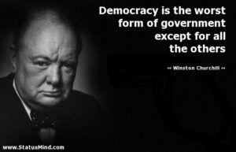
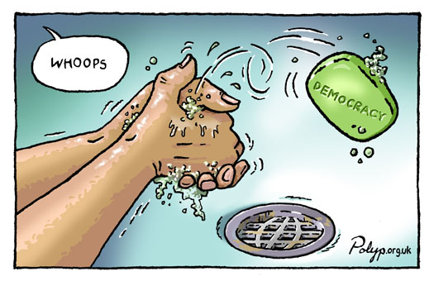
How to think about democratic dissatisfaction and populism in Europe
Sheri Berman, Barnard College
FPA Teacher’s Conference
July 9, 2019

Slide 2
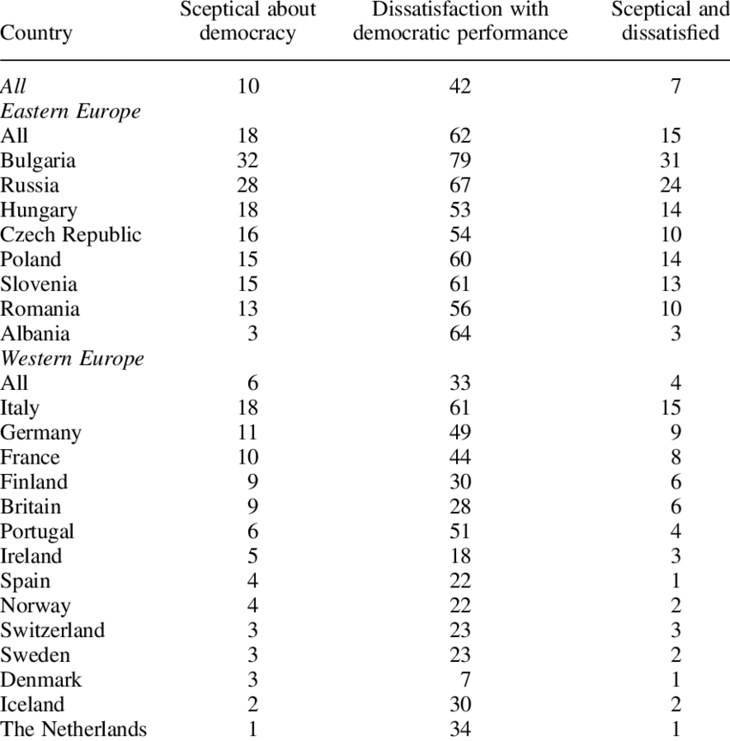
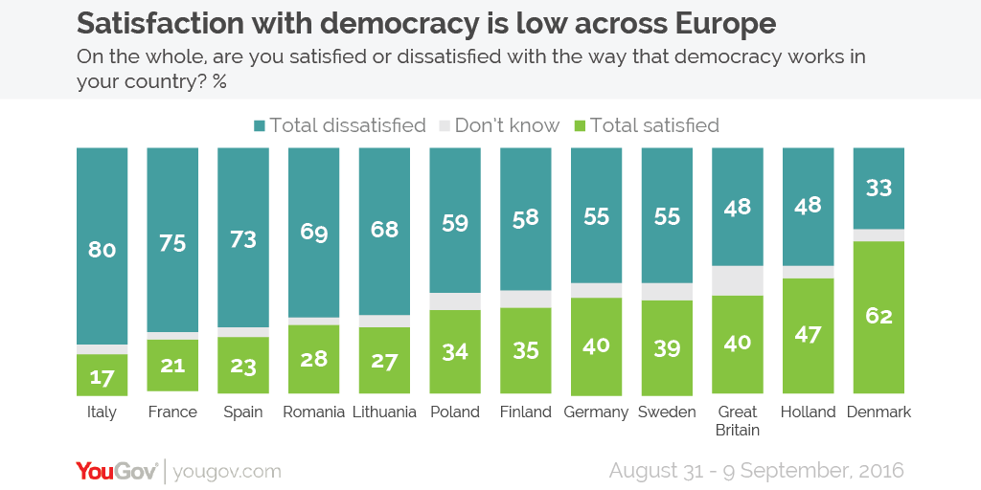
Dissatisfaction with Democracy
Jeffrey Karp, “Democratic Scepticism and Political Participation in Europe,”
Journal of Elections Public Opinion & Parties 25(1), February 2015.

Slide 3
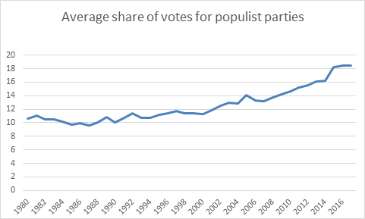
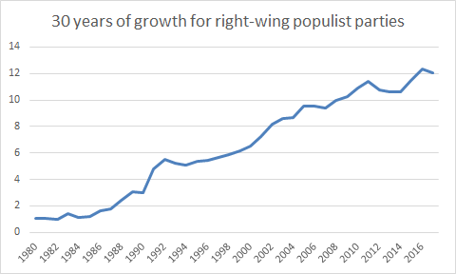
Increasing votes for populist parties in Europe

Slide 4
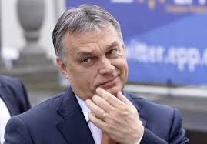

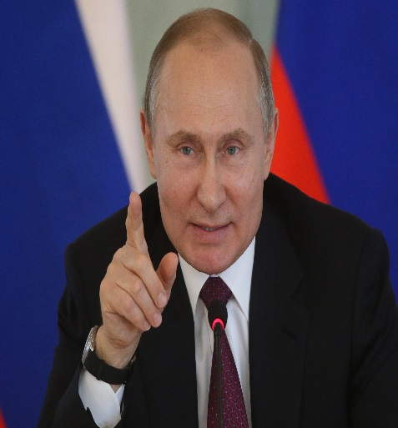
“The era of liberal democracy is over”
“We are in the midst of a populist, nationalist revolt”
“The liberal idea has become obsolete”

Slide 5
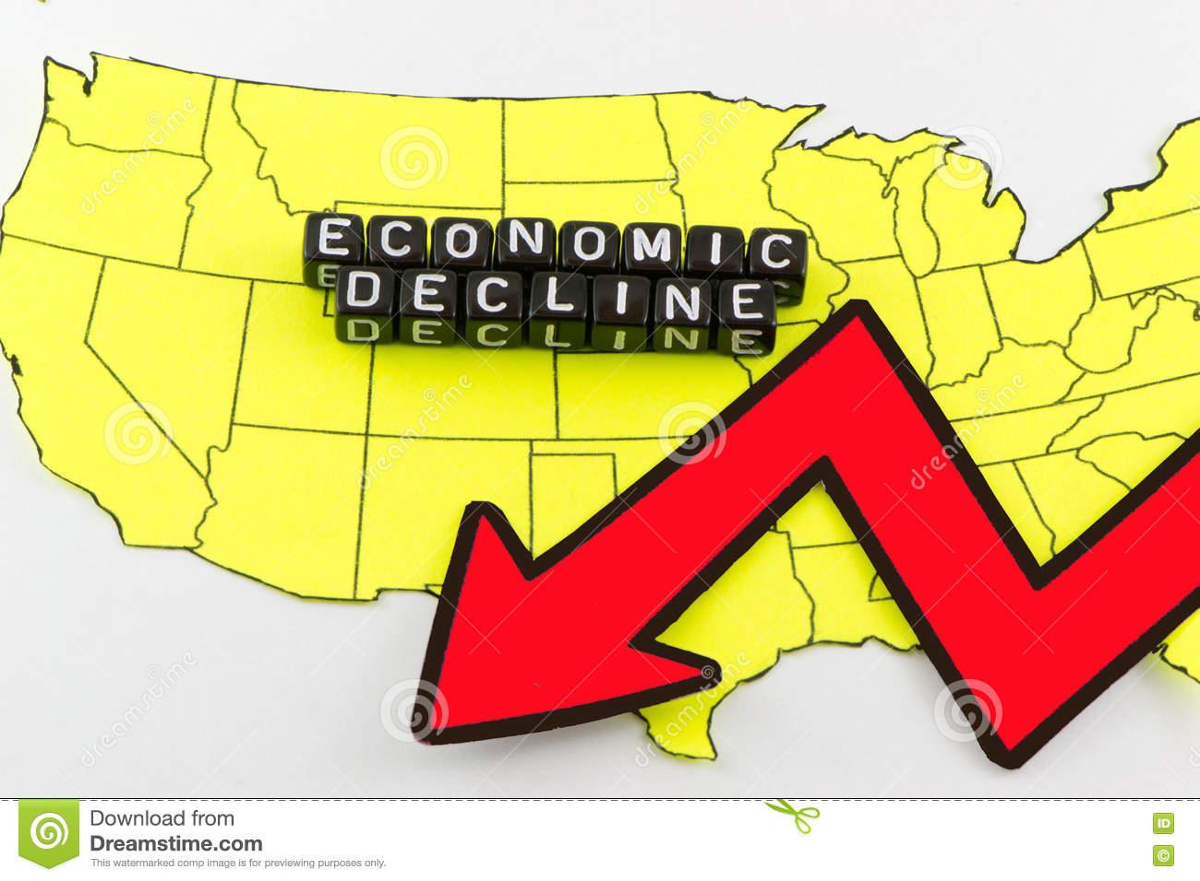

Causes: Demand Side
Economic variables/explanations
Social variables/explanations

Slide 6
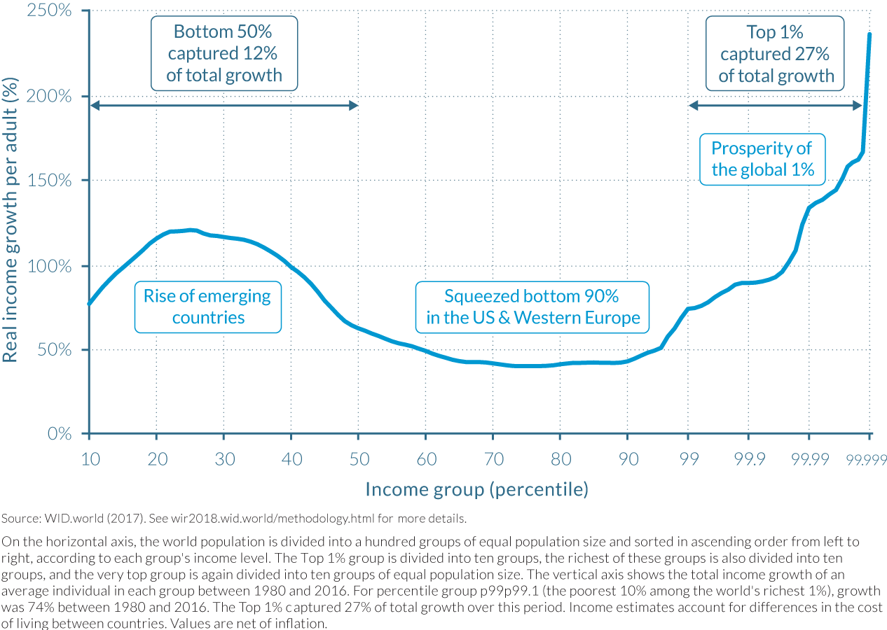
Economic development has created or aggravated divisions within and between societies and increased dissatisfaction with democracy (1980-2016).

Slide 7
In this view those suffering most from economic trends most likely to become dissatisfied with democracy and vote populist
Globalization’s losers
Those with low education, members of the working class, those in declining sectors and/or sectors facing stiff international competition
Geography: those living in economically depressed regions and rural areas

Slide 8
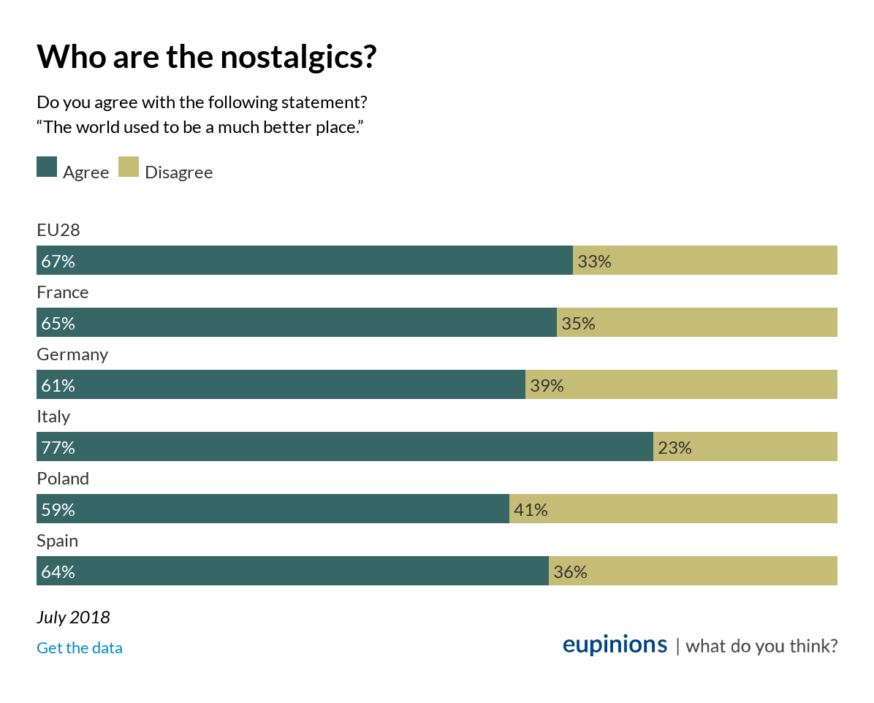
Social and cultural trends have disrupted existing status and political hierarchies, making many white citizens in particular uncomfortable, resentful, and angry.

Slide 9
In this view those most uncomfortable with social and cultural trends most likely to become dissatisfied with democracy and vote populist
White/nativist backlash (feel “left behind”)
Backlash against immigration (in U.S. backlash also against increasing mobilization and empowerment of minority groups)
War against “tradition” beginning in 1960s: “When are they going to start rolling out the boxcars to start hauling off Christians?” (Tony Perkins, President of the family research council)
Populist voters are racists, reactionaries, authoritarians, etc.

Slide 10
Demand-side explanations
Micro vs macro evidence
Interactions:
  Tendency to scapegoat immigrants and minorities rises during difficult economic times when low-income citizens in particular are worried about their economic situation and concerned about competition over scarce public resources, such as housing and health care.
  Social values and preferences are shaped by economic position and context.

Slide 11
Supply-side explanations
Grievances, like attitudes and preferences more generally, are not simply or directly translated into political outcomes.
Such things only become politically salient or powerful when mobilized and organized by politicians and parties.
Understanding populism, in other words, also requires paying attention to the ‘supply-side’ of politics: politicians, parties and other political actors/ institutions.

Slide 12
Supply-side variables: parties
Populist parties : moderation, economic policy shift
Mainstream parties:
  Center-left parties
  Center-right parties
  Convergence, grand coalitions.

Slide 13
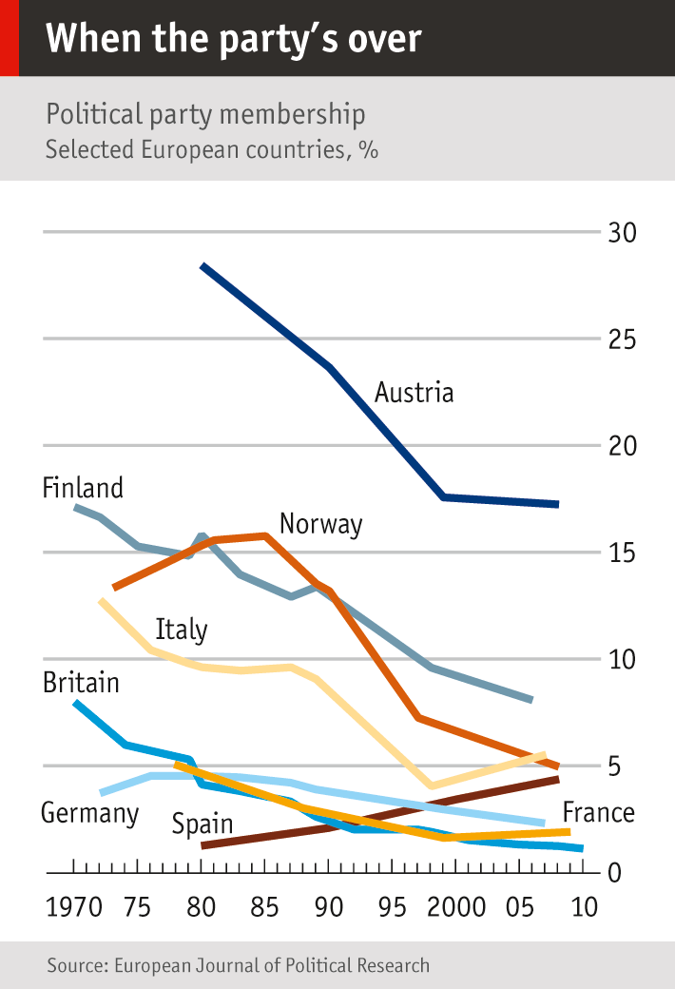
Political parties
Membership decline
Declining ties to civil society organizations
Declining ties to/cultivation of local-level activists.
Leadership with fewer ties to grass-roots overall.
As the late Peter Mair, perhaps the most insightful analyst of European party systems put it, “The age of party democracy has passed. Although the parties themselves remain, they have become so disconnected from the wider society, and pursue a form of competition that is so lacking in meaning, that they no longer seem capable of sustaining democracy.”
“Citizens have turned from being participants into spectators.”
Ruling the Void (Verso 2013), p. 1.
Notes:
Historically, parties stronger in Europe than US
-played greater role linking citizens to elites/governments and structuring political competition

Slide 14
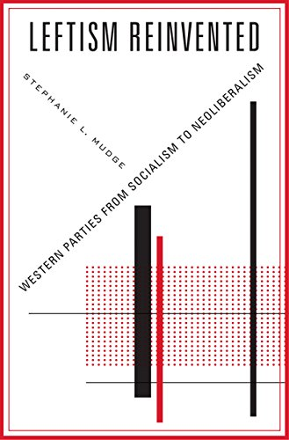

Supply side variables: politicians and other elites
Notes:
Earlier era: socialist activists or Keynesian economists, but…
by the late twentieth century these parties’ economic policy-making was dominated by “trans-national finance-oriented economists” and neo-liberal think-tank based policy wonks who viewed themselves as interpreters of markets and their mission in technocratic, efficiency terms and accordingly urged the left to embrace globalization, de-regulation, welfare-state retrenchment and other reforms that alienated and angered their traditional voters.
overall leadership shifted towards a highly-educated elite whose preferences, particularly on issues like the benefits of the E.U., immigration and cultural change diverged greatly from those of their traditional voters.
Brady, David W. and Ferejohn, John A. and Paparo, Aldo, Immigration Attitudes and the Politics of Globalization (August 7, 2016). Available at SSRN: https://ssrn.com/abstract=2820204 or http://dx.doi.org/10.2139/ssrn.2820204

Slide 15
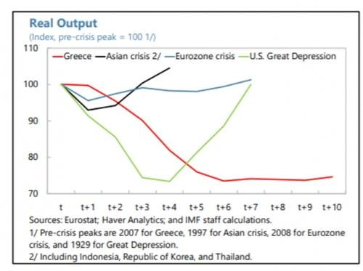
Supply-side variables: The EU
DIRECTLY: by negating or over-ruling democratically elected leaders and governments.
European commission President Juncker speaking of the imposition of austerity policies: “We sinned against the dignity of the people in Greece, Portugal and sometimes Ireland.
Notes:
literally forced democratically expressed votes to be nullified
-clearest in Greece…..GO TO JUNCKER QUOTE
took key economic tools out of hands of democratically elected national governments
BICKERTON’S IDEA OF “member-states” to capture reduced
sovereignty

Slide 16
Supply-side variables: The EU
INDIRECTLY: constraining party competition: e.g., “As the commitments deriving from EU membership increase, the policy positions of mainstream parties converged and governments became more constrained in terms of the policies they [could] implement.”
(e.g. Kyriki Nanou and Han Dorusson, “European integration and electoral democracy: How the European Union constrains party competition in the member-states,” EJPR, 52, 2013).

Slide 17

Supply-side variables: technocracy
Ever more policy-making areas fell under the purview of the E.U. without any corresponding increase in European citizens’ power over them.
Tucker: “traditionally, policies with such immense distributional impact were left to elected leaders, but no one elects a central bank.” The problem, of course, is that central bankers, like other technocrats, tend only to ask whether a policy is “effective,” when equally if not more important is whether it is legitimate since citizens are more likely to tolerate the “inevitable disappointments and frustrations of” policy when they can vote out those whose decisions they disagree with.
Notes:
EPITOME OF THIS TREND WAS CENTRAL BANKS AND IN PARTICULAR ECB
ECB: granted increasing independence and increasing power over the past decades, purchasing sovereign debt, intervening in commercial debt, real-estate, and mortgage markets and being granted oversight over financial systems.

Slide 18

Conclusions and causality
If we want to understand—and address—democratic dissatisfaction and populism, must resist instinct for mono-causal explanations.
Need to look at interactions, and at both demand and supply-side.
“What we want above all is respect”— leaders and government should not ignore our needs and concerns.
(Benjamin Cauchy, a leader of France’s Yellow Vest movement.)
Notes:
1. PARSIMONY VS ACCURACY
INSTITUTIONS TRANSLATE LONG-TERM, STRUCTURAL TRENDS INTO POLI SPHERE
They must therefore be crucial part of any COMPLETE explanation demo dissatisfaction and populism
SKOCPOL: can they respond to challenges?
HUNTINGTON: can they recognize and respond to citizen demands?
EVIDENCE SAYS “no”
-leaving many people feeling UNREPRESENTED AND PROBLEMS IGNORED
3. As one leader of the “yellow vests” movement in France explained….

Slide 19



Democratic Dissatisfaction feeds off the sense that democracy is not responding to all citizens—allowing populists to claim to be the voice of “the people”
Marine Le Pen: “The aim of our program is to give the people a voice.” (Campaign: “In the name of the people.” #AuNomDuPeuple )
Donald Trump “I am your voice. The voice of the forgotten people…Today we are transferring power…back to you, the people.”
https://www.youtube.com/watch?v=BEuboZ98TxE
https://www.youtube.com/watch?v=FYWnuQc5mYA

Slide 20
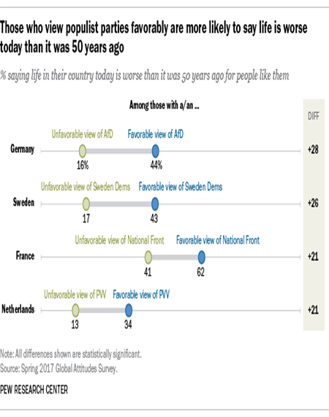
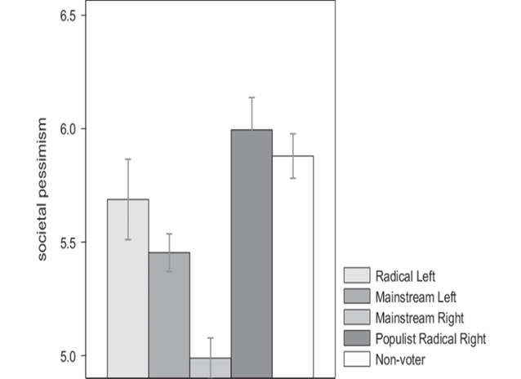
Populist voters are particularly pessimistic

Slide 21
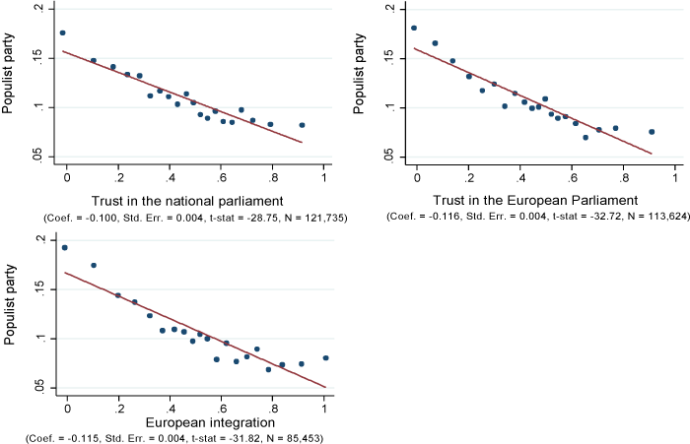
Populist Voters have lost trust in democratic institutions
(Average probability of having voted for a populist party in the last general election for a given level of trust in the national parliament, holding age, gender and educational attainment constant and controlling for time trends and country differences.)
The vertical axis of each panel reports the likelihood of voting for a populist party. The horizontal axis reports the value of the respective attitude variable.
Europe's Trust Deficit: Causes and Remedies Christian Dustmann, Barry Eichengreen, Sebastian Otten, André Sapir, Guido Tabellini, Gylfi Zoega 23 August 2017
https://voxeu.org/content/europes-trust-deficit-causes-and-remedies

