Slide 1
Unit 1: What is a country?
Day 7 Slides
Do Now:
What do national borders actually represent?
Why do nation states need borders?
What factors may cause nation states to have disputes over their borders?

Slide 2
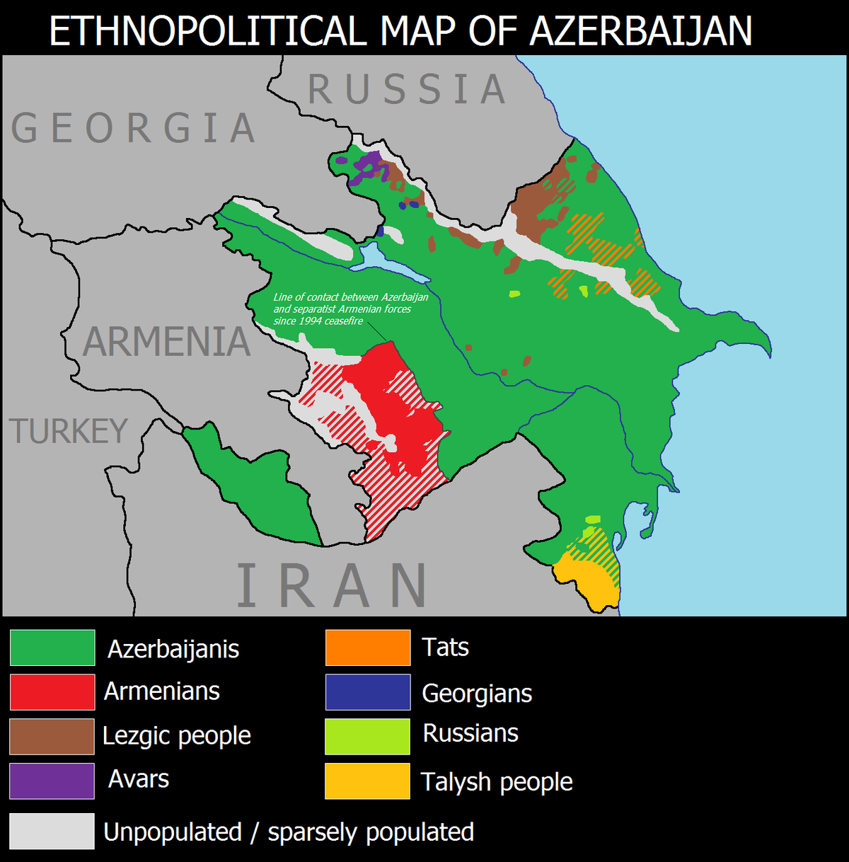
Azerbaijan and Armenia
Notes:
To what extent do the national boundaries reflect the identities of where different ethnic groups live?

Slide 3
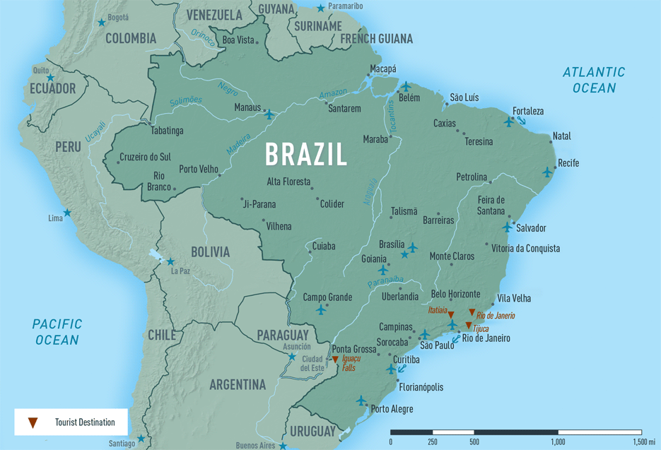
Brazil and the Amazon

Slide 4
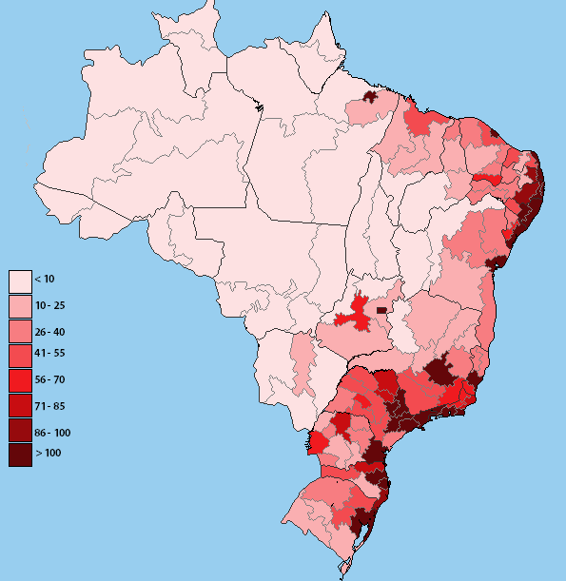
Brazil and the Amazon
Notes:
In a democracy, we have “popular sovereignty.” People vote and decide what happens inside of their borders which may include areas very far from where the people live. In Brazil, most of the people live on the coast but they get to decide what happens inside of the borders of the country including the more sparsely populated areas in the Amazon.

Slide 5
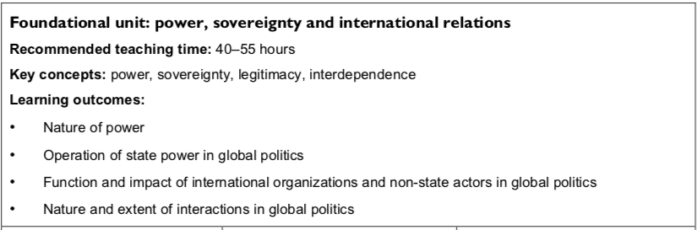

Slide 6
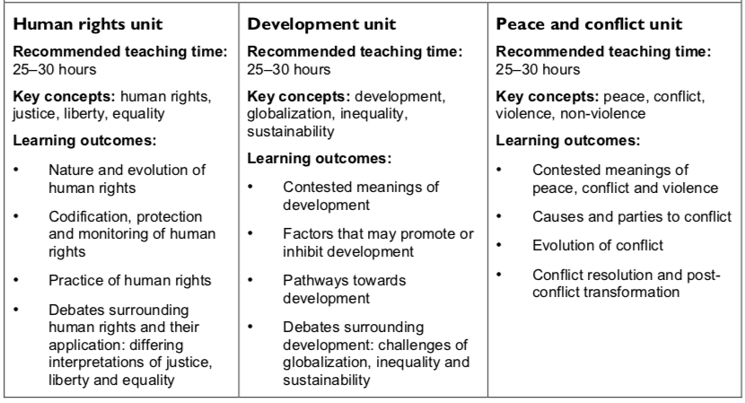

Slide 7
Global Political Challenges
Borders
Identity
Poverty
Health
Environment
Security

Slide 8
End of unit assessment
Let’s look over the assignment.
Quick note, this is to be submitted on turnitin.com
By tomorrow, sign up with your group along with your choice of place to study. If your name isn’t on the list, you will be assigned.

