Slide 1
Individual vs. Collective Rights
Quick review on the unit so far
Definition of human rights: Basic rights, freedoms, and protections that all people are entitled to regardless of who they are and where they live.

Slide 2
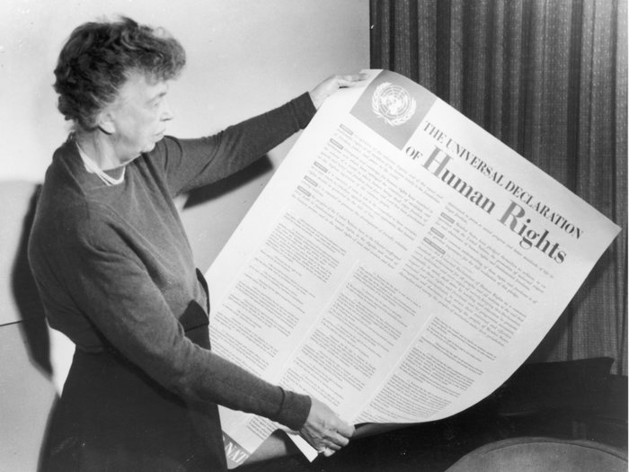
Universal Declaration of Human Rights
Modern concept of human rights is enshrined in the UDHR.

Slide 3
Four Assumptions About Human Rights
Assumptions contained within human rights are that they are:
Universal: apply to everyone
Interdependent: violating one often is associating others
Indivisible: all rights are equally important
Inalienable: cannot be taken away

Slide 4
Upholding Human Rights
Ensuring that human rights are upheld, there are four core responsibilities:
Codification: Human rights need to be put into law
Protection: Once in law, these rights need to be protected
Promotion: NGOs, IGOs, and nation states can push for greater acceptance of rights around the world
Monitoring: We need to make sure that we know whether rights are being respected

Slide 5
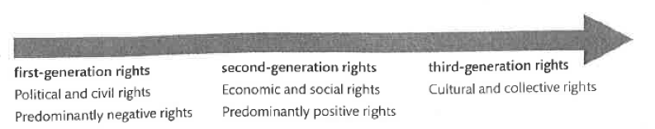
Three “generations” of beliefs about human rights

Slide 6
Negative rights and first generation rights
Rights that require that individuals be left alone – that governments do not interfere or use its power against individual
First generation human rights – civil and political rights of individuals
Life, liberty, property
Freedom from torture
Freedom of thought, religion
Equality before the law
Freedom from arbitrary arrest and detention

Slide 7
Positive human rights and second generation human rights
Rights which governments must take action in order to protect the people
Second generation human rights – economic, social and cultural rights of individuals
Free education
Work and equal pay for work
Adequate standard of living
Access to rest and leisure

Slide 8
Collective rights and third generation rights
Rights that apply to communities as well as individuals
Protection of the environment
Peace
Sustainable development
Why are these considered “collective” rather than individual?

Slide 9
UN Declaration of the Rights of Indigenous Peoples (2007) UNDRIP

Slide 10
Who are indigenous people?
According to Amnesty International (an NGO focused on promoting human rights) states that: There are 370 million Indigenous people around the world and spread across more than 90 countries. They belong to more than 5,000 different Indigenous peoples and speak more than 4,000 languages. Indigenous people represent about 5% of the world’s population. The vast majority of them – 70% – live in Asia.

Slide 11
Who counts as “indigenous”?
Self- identification as indigenous peoples at the individual level and accepted by the community as their member.
Historical continuity with pre-colonial and/or pre-settler societies
Strong link to territories and surrounding natural resources
Distinct social, economic or political systems
Distinct language, culture and beliefs
Form non-dominant groups of society
Resolve to maintain and reproduce their ancestral environments and systems as distinctive peoples and communities.

Slide 12
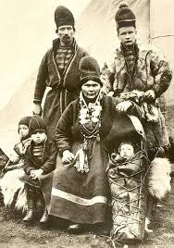
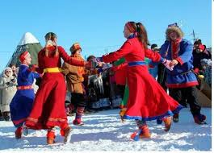
Sami people of Scandinavia

Slide 13
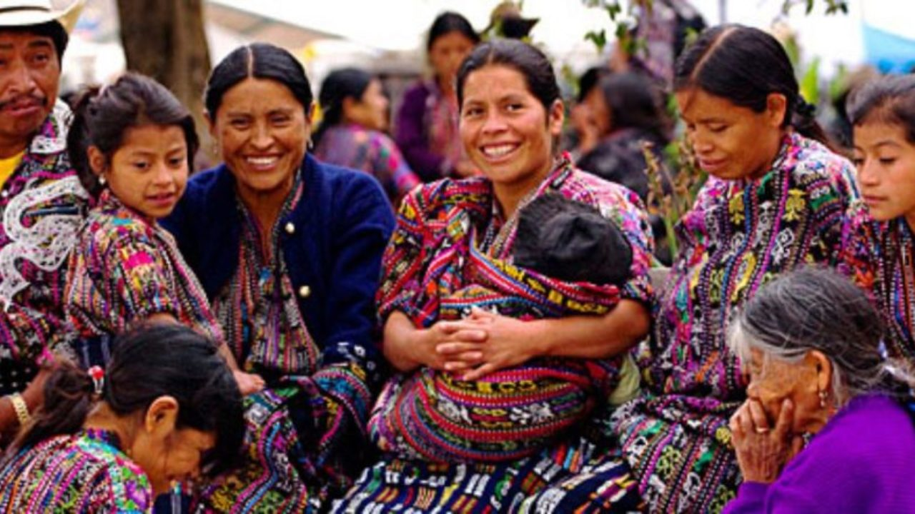
Mayan people of Guatemala

Slide 14
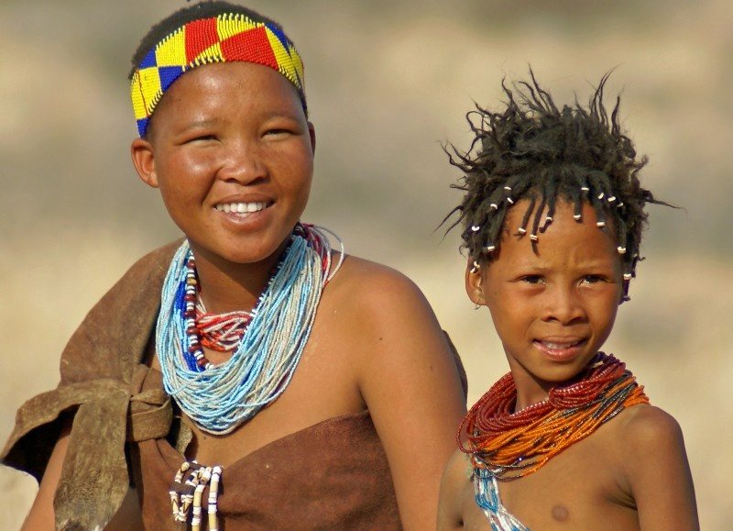
San people of southern Africa

Slide 15
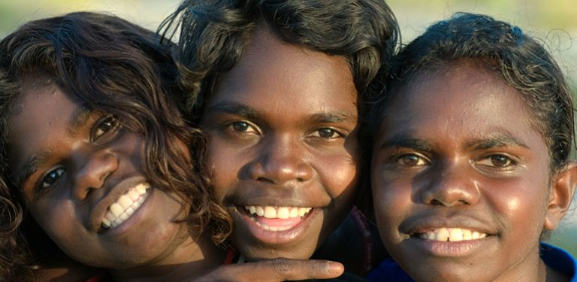
Aboriginies in Australia

Slide 16
Why did Indigenous People Need a Separate UN Treaty?
Those who did research on UNDRIP, what can you tell us about it?

Slide 17
Carlisle School in Pennsylvania
Boarding school for native children 1879-1918
Believed that the only way to save native people in the Americas was to force them to assimilate to mainstream American culture
“Kill the Indian: Save the man”

Slide 18
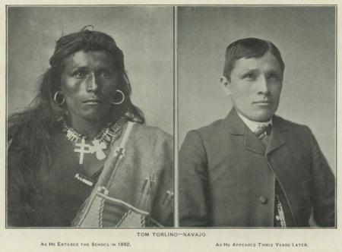

Slide 19
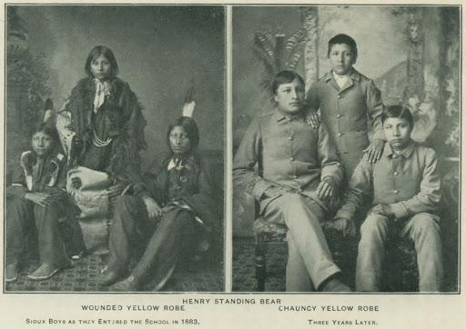

Slide 20
“Stolen Generations” in Australia
Between 1910-1970, many aboriginal children were forcibly removed from their families and adopted by white Australian families to force assimilation onto the native people of Australia.
Similar practices in Canada and New Zealand.
I mention these four countries because these were four countries that refused to sign the UNDRIP initially.

Slide 21
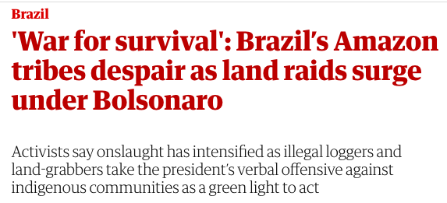

Slide 22
Why did Indigenous People Need a Separate UN Treaty?
Part of the story is the fact that indigenous peoples have been targeted by many nation states and had their individual rights violated.
In addition, the nature of many indigenous cultures does not fit with the western concept of individual rights. These groups wanted a document that explicitly addressed their concepts of “collective” rights.

Slide 23
UNDRIP Article 1
“Indigenous peoples have the right to the full enjoyment, as a collective or as individuals, of all human rights and fundamental freedoms as recognized in the Charter of the United Nations, the Universal Declaration of Human Rights and international human rights law.”

Slide 24
UNDRIP Also Includes
Rights of indigenous individuals and people to protect their culture through practices, languages, education, media, and religion.
Right to collective land ownership and self determination over what happens to their land and on their land.
These rights generally revolve around the rights of distinct groups to maintain a distinct identity and be free from harm at the hands of a more powerful government

Slide 25
Contrast these ideas with western individual concepts of land ownership?
How do we think about private property? About moving from place to place? What is the relationship between place and identity?

Slide 26
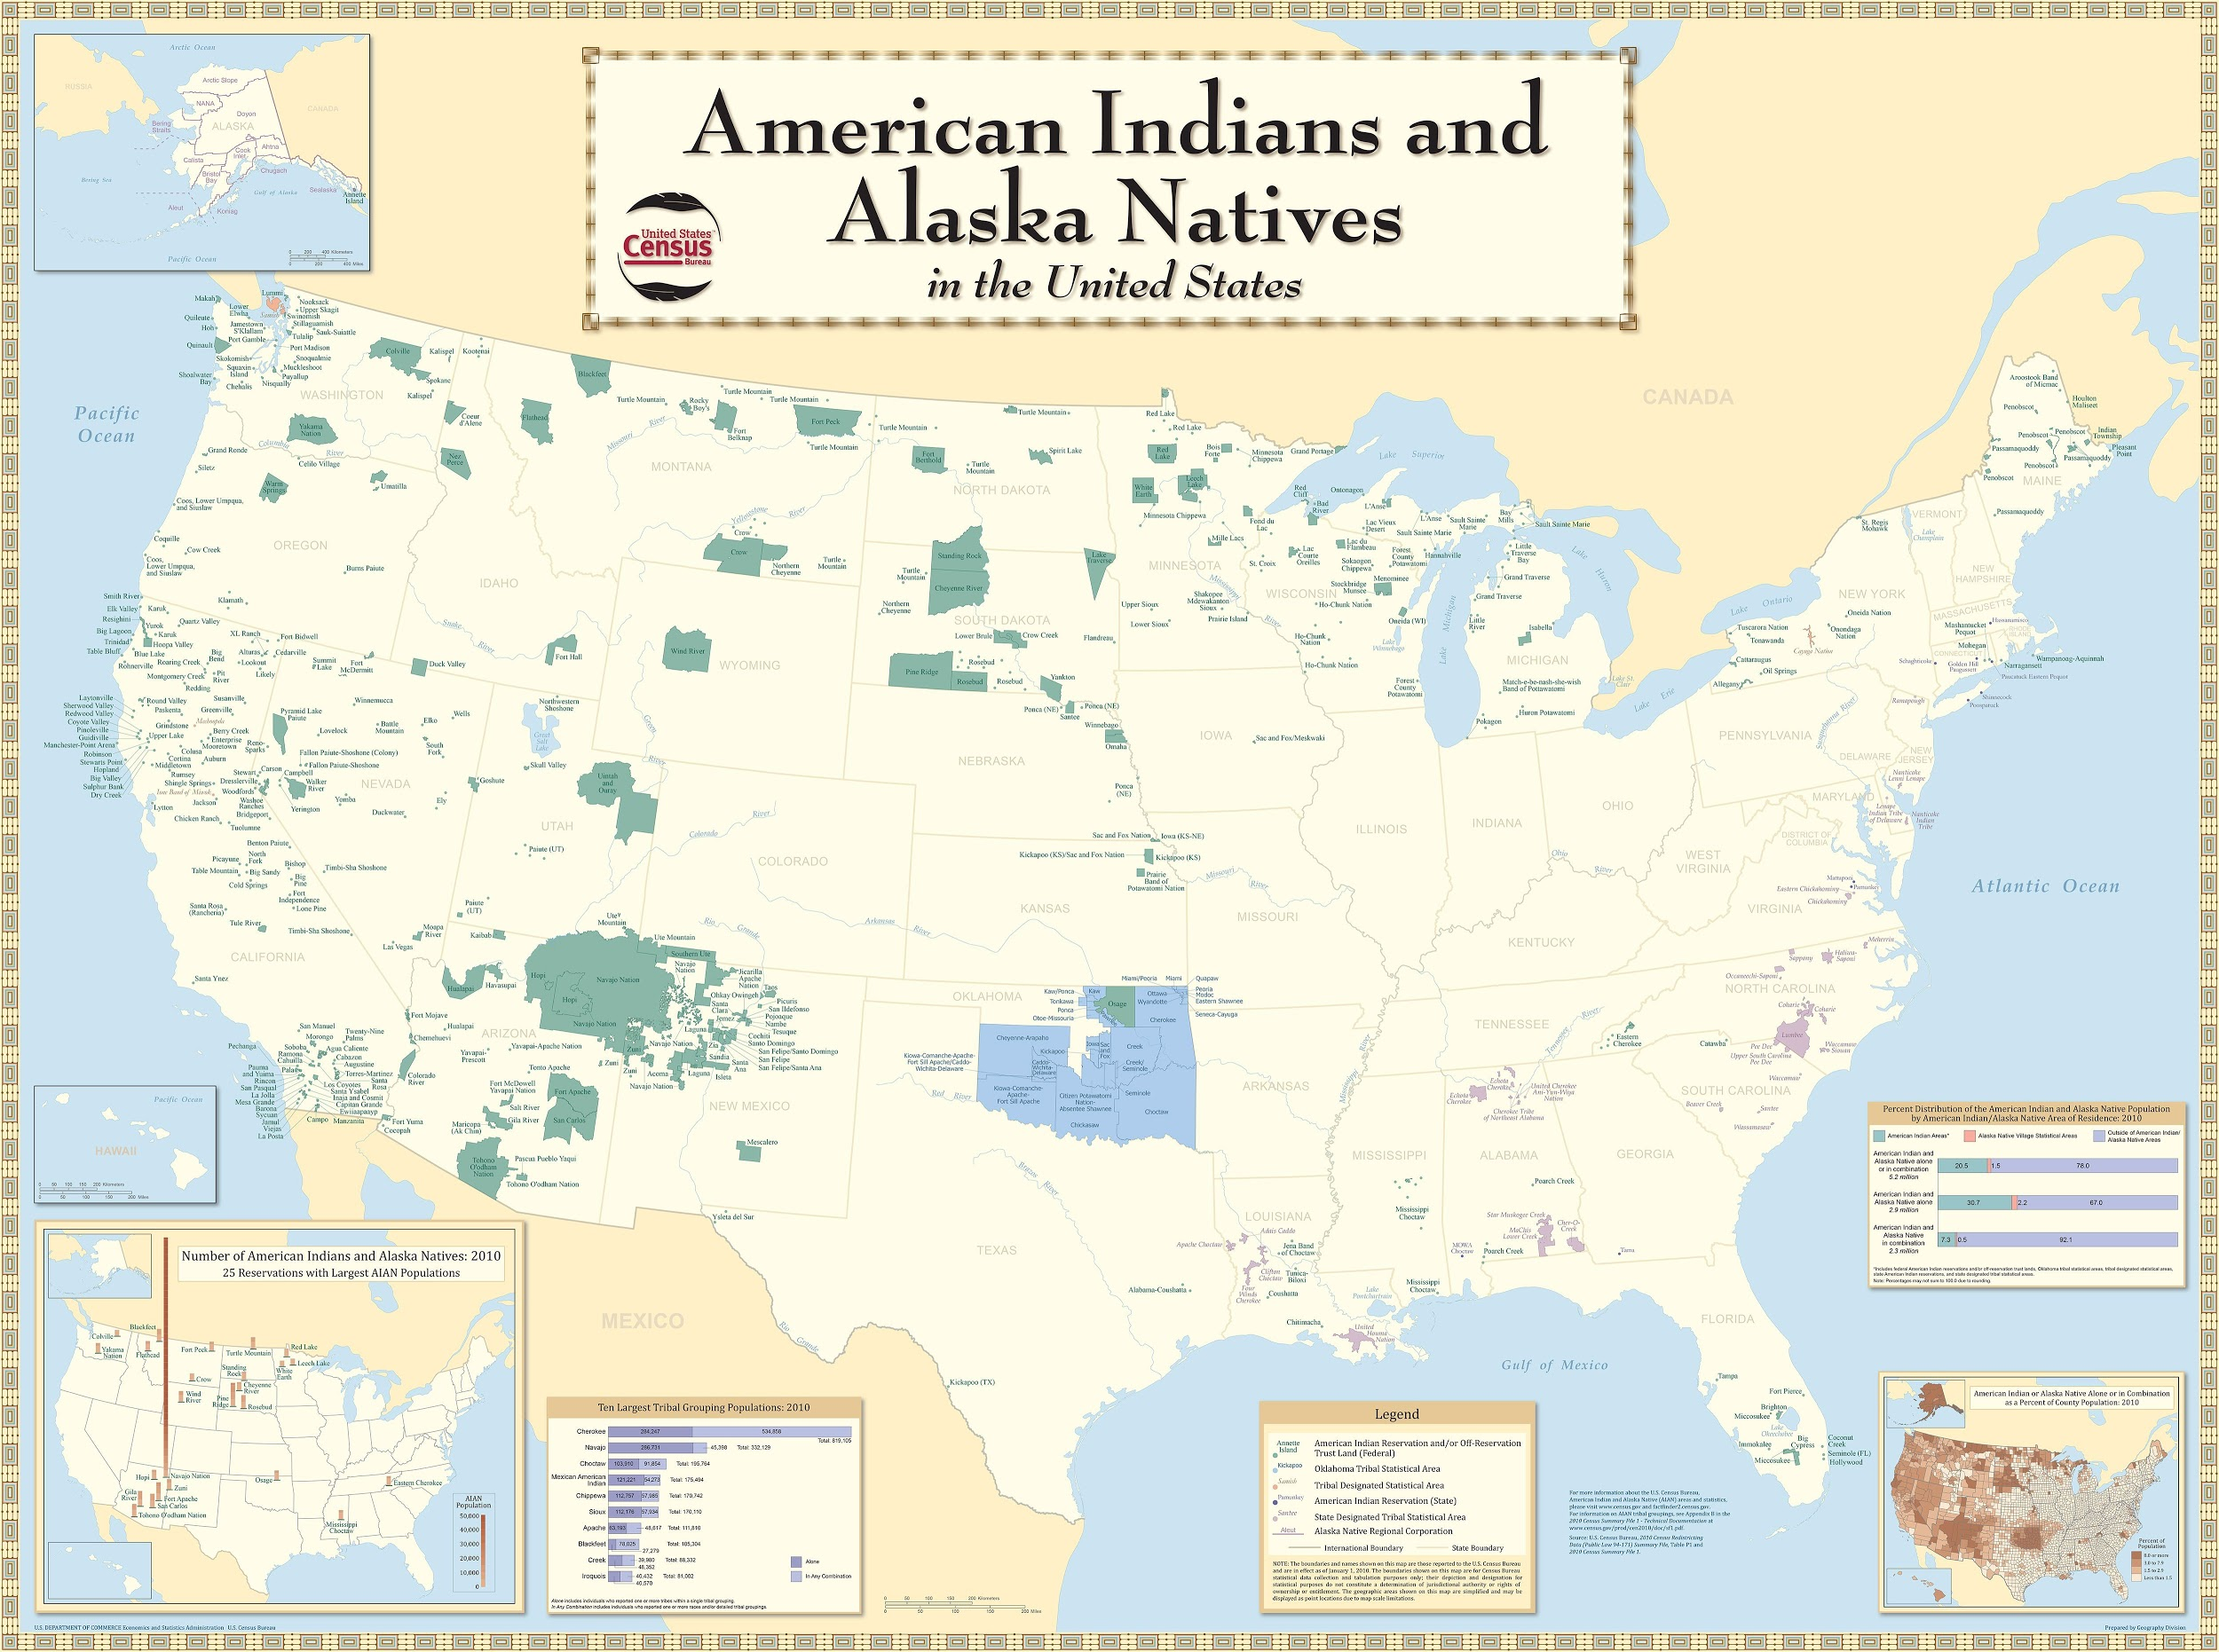

Slide 27
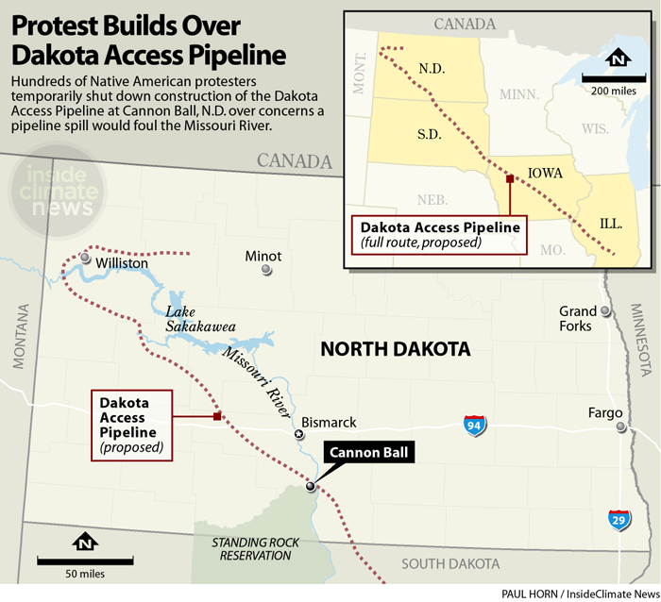

Slide 28
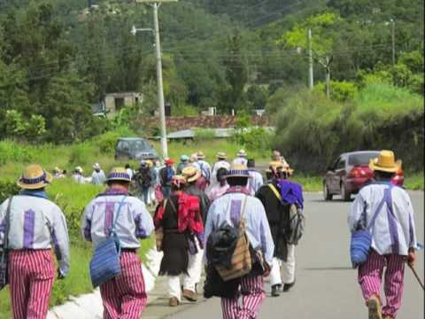
Cultural Survival: An Interview with Mark Camp

