Slide 1
Case #2: Saudi Arabia’s Guardianship System

Slide 2
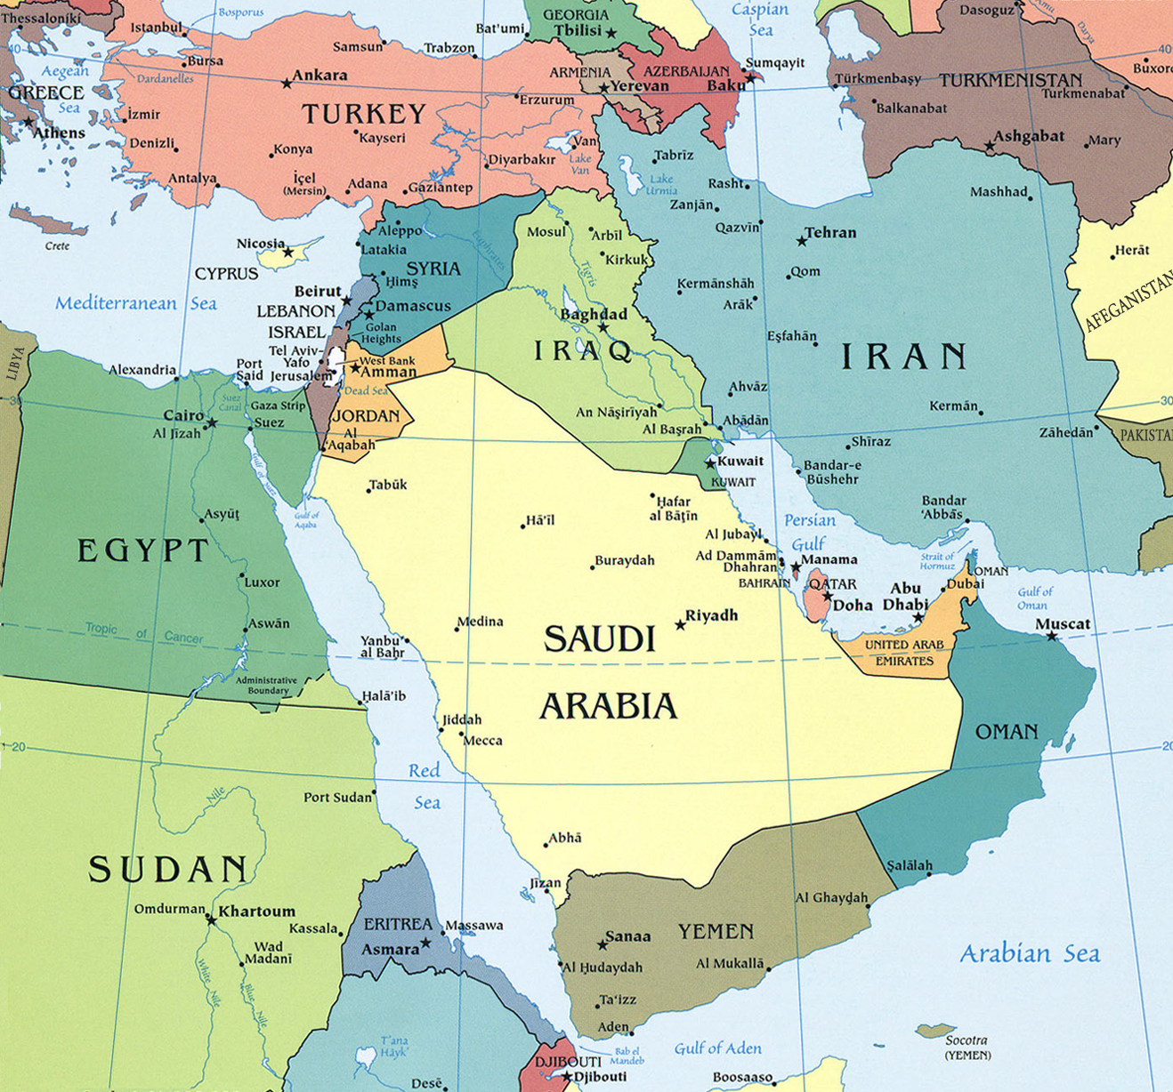

Slide 3
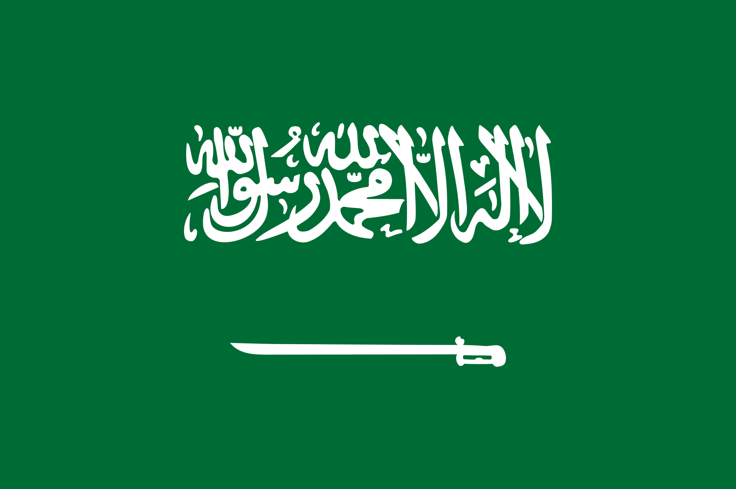
Key statistics
Population: ~34,100,000 41st out of 200 nations. Around 1/10 of the U.S. Over 30% of its population is comprised of immigrants.
GDP: $1.8 trillion 16th in the world.
Main export: petroleum and related products 90%. It also has the 2nd most proven oil reserves in the world.
Main religion: Sunni Islam (85% Sunni 15% Shia)
Main language: Arabic

Slide 4
Islam in the world
There are over 1.5 billion Muslims in the world. Around 25% of the world’s population
For reference, here are other major religions:
Christianity 2.3 billion (combines Catholic, Protestant, Orthodox sects) (29%)
Hinduism 1.1 billion (14%)
Buddhism 506 million (6%)
Judaism 14 million (0.18%)

Slide 5
Countries with the largest Muslim populations
Nation | Muslim Population
1. Indonesia | 229,000,000
2. Pakistan | 202,000,000
3. India | 195,000,000
4. Bangladesh | 153,000,000
15. Saudi Arabia | 31,000,000

Slide 6
Saudi Arabia’s history
Between the 16th and 20th centuries, the Arabian peninsula was controlled by the Ottoman Empire. A Saudi “state” existed on and off during this time as well.
After World War I, the defeat of the Ottoman Empire paved the way for a Saudi nation state which formed officially in 1932 with rulers for the Saud family as its leaders.
In 1938, vast oil reserves were discovered with help from the US. This led to rapid change in Saudi Arabia.

Slide 7
Islam in Saudi Arabia
Saudi Arabia has a Sunni majority but just like any religion, there is a tremendous variety of Muslims and practices. There was a religious philosophy that was popular in Saudi Arabia, Wahhabism, who were extremely literal in their reading of religious text. Historically, this was a movement that had limited appeal and exposure outside of a small part of the Arabian peninsula.
With the foundation of the nation state of Saudi Arabia, that changed.
Despite its small Muslim population, the presence Muslim holy sites along with lots of money from oil, Saudi Arabia has global reach and globalized its influence.

Slide 8
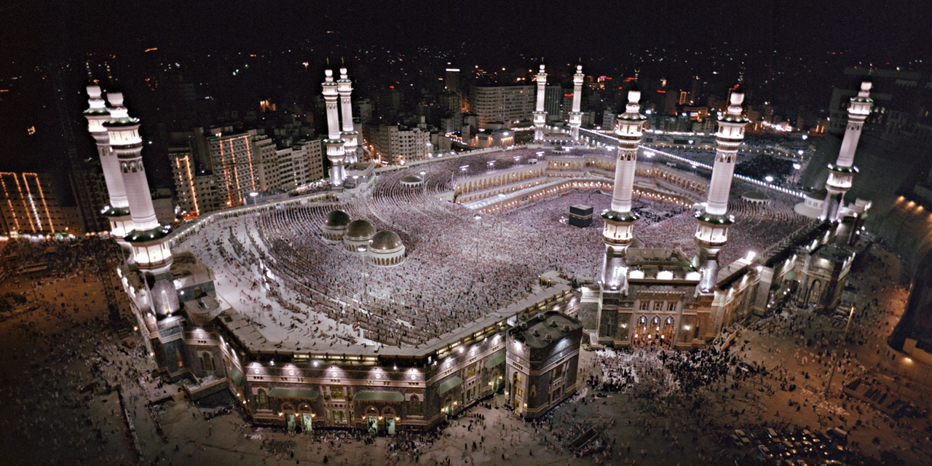
The Grand Mosque

Slide 9
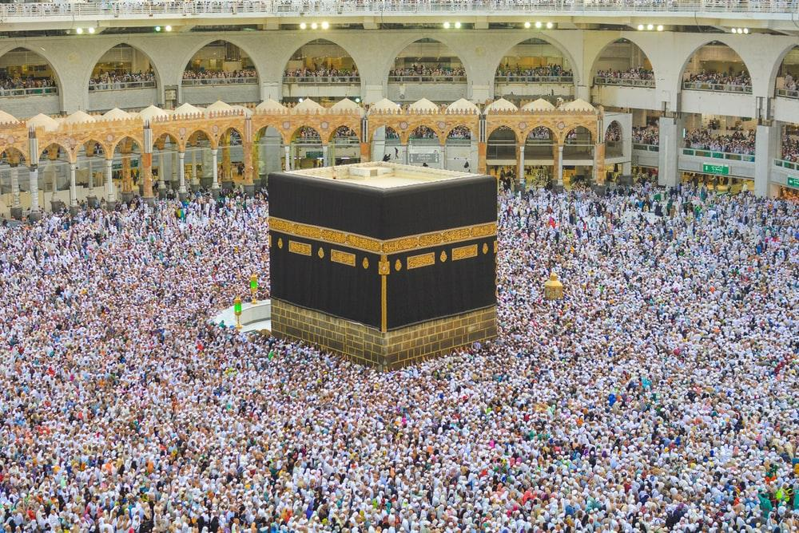
The Kaaba

Slide 10
Wahhabism in Saudi Arabia
The ruling Saud family has held an alliance with Wahhabi religious fundamentalists for hundreds of years and this alliance helped them conquer the Arabian Peninsula and maintain control. This alliance is at the heart of a complicated relationship in Saudi Arabia. Religious fundamentalists hold a lot of power in Saudi Arabia and the Saud family rulers try to stay maintain a good relationship with them.
The very legitimacy of the Saud family rule over Saudi Arabia hinges on this relationship. If they don’t keep the fundamentalists happy, they fear being overthrown.

Slide 11
1979 Iranian Revolution
A religious revolution led by radical Shia Muslims frightened Saudi leaders and made them worry about revolutions in their own country or in neighboring countries.
Saudi Arabia had long since seen itself as the legitimate leaders of the Muslim world and refocused their efforts to maintain that leadership after 1979.
Among many Sunni majority nations, 1979 was a turning point that led to increasingly conservative religious beliefs and more power for religious authorities.

Slide 12
1979 Grand Mosque Seizure
Over two hundred armed, Sunni fundamentalists took control of the grand mosque and held hostage around 50,000 people.
It took two weeks and the help of French special forces to finally take back control. The impacts were long lasting.
The leader of the armed take over claimed that "the ruling Al-Saud dynasty had lost its legitimacy because it was corrupt, ostentatious and had destroyed Saudi culture by an aggressive policy of Westernization". He regarded radio, television and working women to be great "evils."

Slide 13
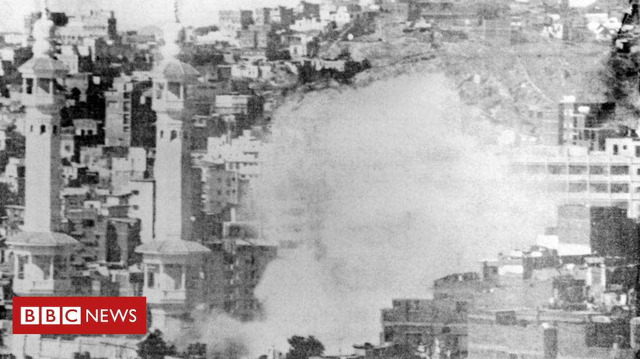

Slide 14


Slide 15
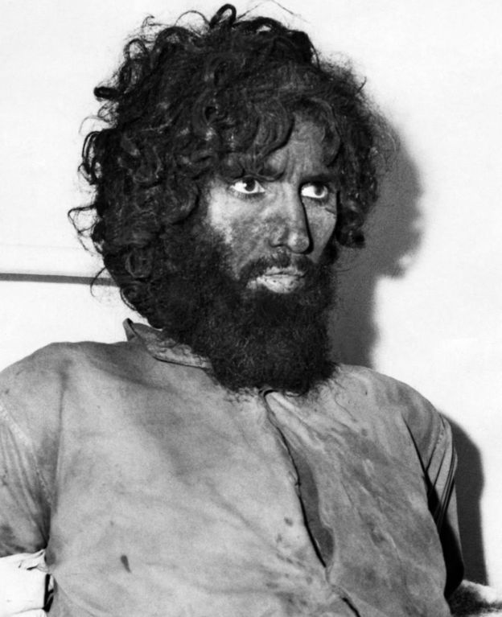

Slide 16
1979 Grand Mosque Seizure
The Saudi government gave more power to the Wahhabist clerics in the country and started strictly enforcing religious laws and promoting these views around the world.
All of this was with the goal of staying in power and maintaining legitimacy in the eyes of the religious groups inside of Saudi Arabia who had the power to undermine the rule of the Saud family.

Slide 17
1979 Grand Mosque Seizure
In an interview in March 2018, Crown Prince Mohammed Bin Salman, said that before 1979, "We were living a normal life like the rest of the Gulf countries, women were driving cars, there were movie theatres in Saudi Arabia."
After the incident at the Grand Mosque, that began to change and the result has been four decades of increasingly conservative religious influence that has only started to thaw recently.

Slide 18
1991 Iraqi invasion of Kuwait and the first Gulf War
Iraq, under the leadership of Saddam Hussein, invaded its neighbor, Kuwait and this threatened stability in the entire region.
Saudi Arabia turned to receive help and protection from the U.S. which later established military bases. This was the start of the fallout with Osama bin Laden and al Qaeda who did not want US troops in what was considered holy land.

Slide 19
Homework
Background reading about Saudi Arabia’s government structure and society.

