Slide 1
Day 4 Lecture Slides
What is a country?
Nations and Nation-States Revisited
Definitions are easy, reality is hard.
A “nation” can be defined as any group that has some common identity based on religion, language, ethnicity, or something else entirely.
Is every ethnicity a “nation”?
Should every group of people get their own country?

Slide 2
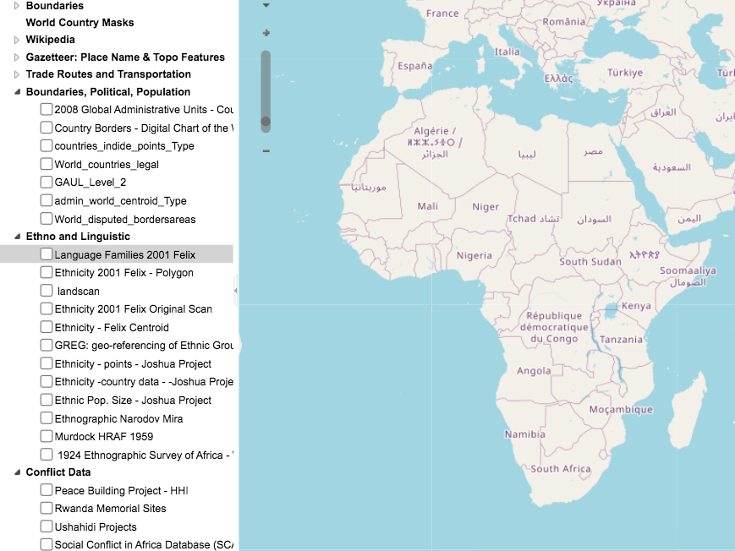
Africa Map of Borders and Ethnicities
http://worldmap.harvard.edu/africamap/
Notes:
http://worldmap.harvard.edu/africamap/

Slide 3
Are all countries literally both nations and states?
It is estimated that less than 10% of UN members are truly “nation-states” where everyone in the state is of some dominant ethnic group.

Slide 4
Review work from last class
With the concept of internal sovereignty, what challenges do you think nation-state might have in having effective control over their own territory?
If the territory is very large, or diverse with language and culture, hard to satisfy everyone’s needs
Languages and cultures might not get along, might have history of conflict
If small, local governments inside the country have a dispute might be hard to resolve
If a large number of people don’t agree or respect the government then hard to govern.

Slide 5
How can nations-states make their control over their territory more effective? In other words, how can nation-states become more cohesive?
Allow all people the right to vote, give people a say.
• Allow for local governments to have some say in local issues.
• Individual rights and responsibilities
• Use the military or law enforcement to keep people in line
• Use force against your own people
• Ethnic cleansing (literally moving people out)
• Genocide
• Force your culture or language onto other people
• Promote national myths and stories, celebrate traditions and holidays (july 4th) Olympics and other things that promote nationalism.

Slide 6
Let’s revisit sovereignty
Sovereignty
Internal Sovereignty
External Sovereignty

Slide 7
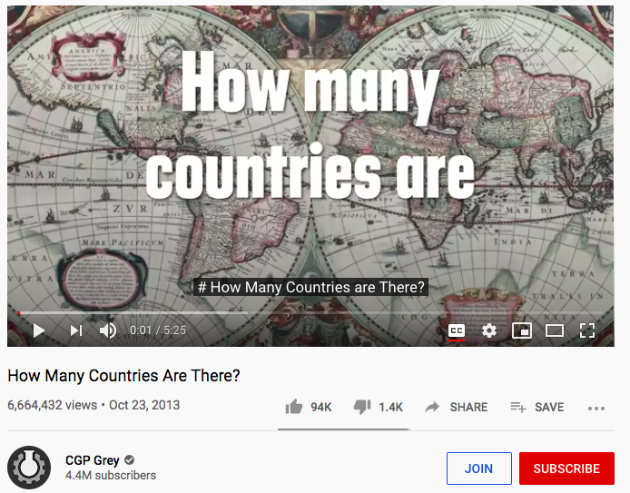
How many countries are there?
Not a simple question. Watch this video.
https://www.youtube.com/watch?v=4AivEQmfPpk
Notes:
https://www.youtube.com/watch?v=4AivEQmfPpk

Slide 8
Sovereignty Activity
Complete the activity questions on today’s worksheet.

